Slide 1
My Projects
Mohamed Elshamy
moh.elshamy@el-eng.menofia.edu.eg

Slide 2

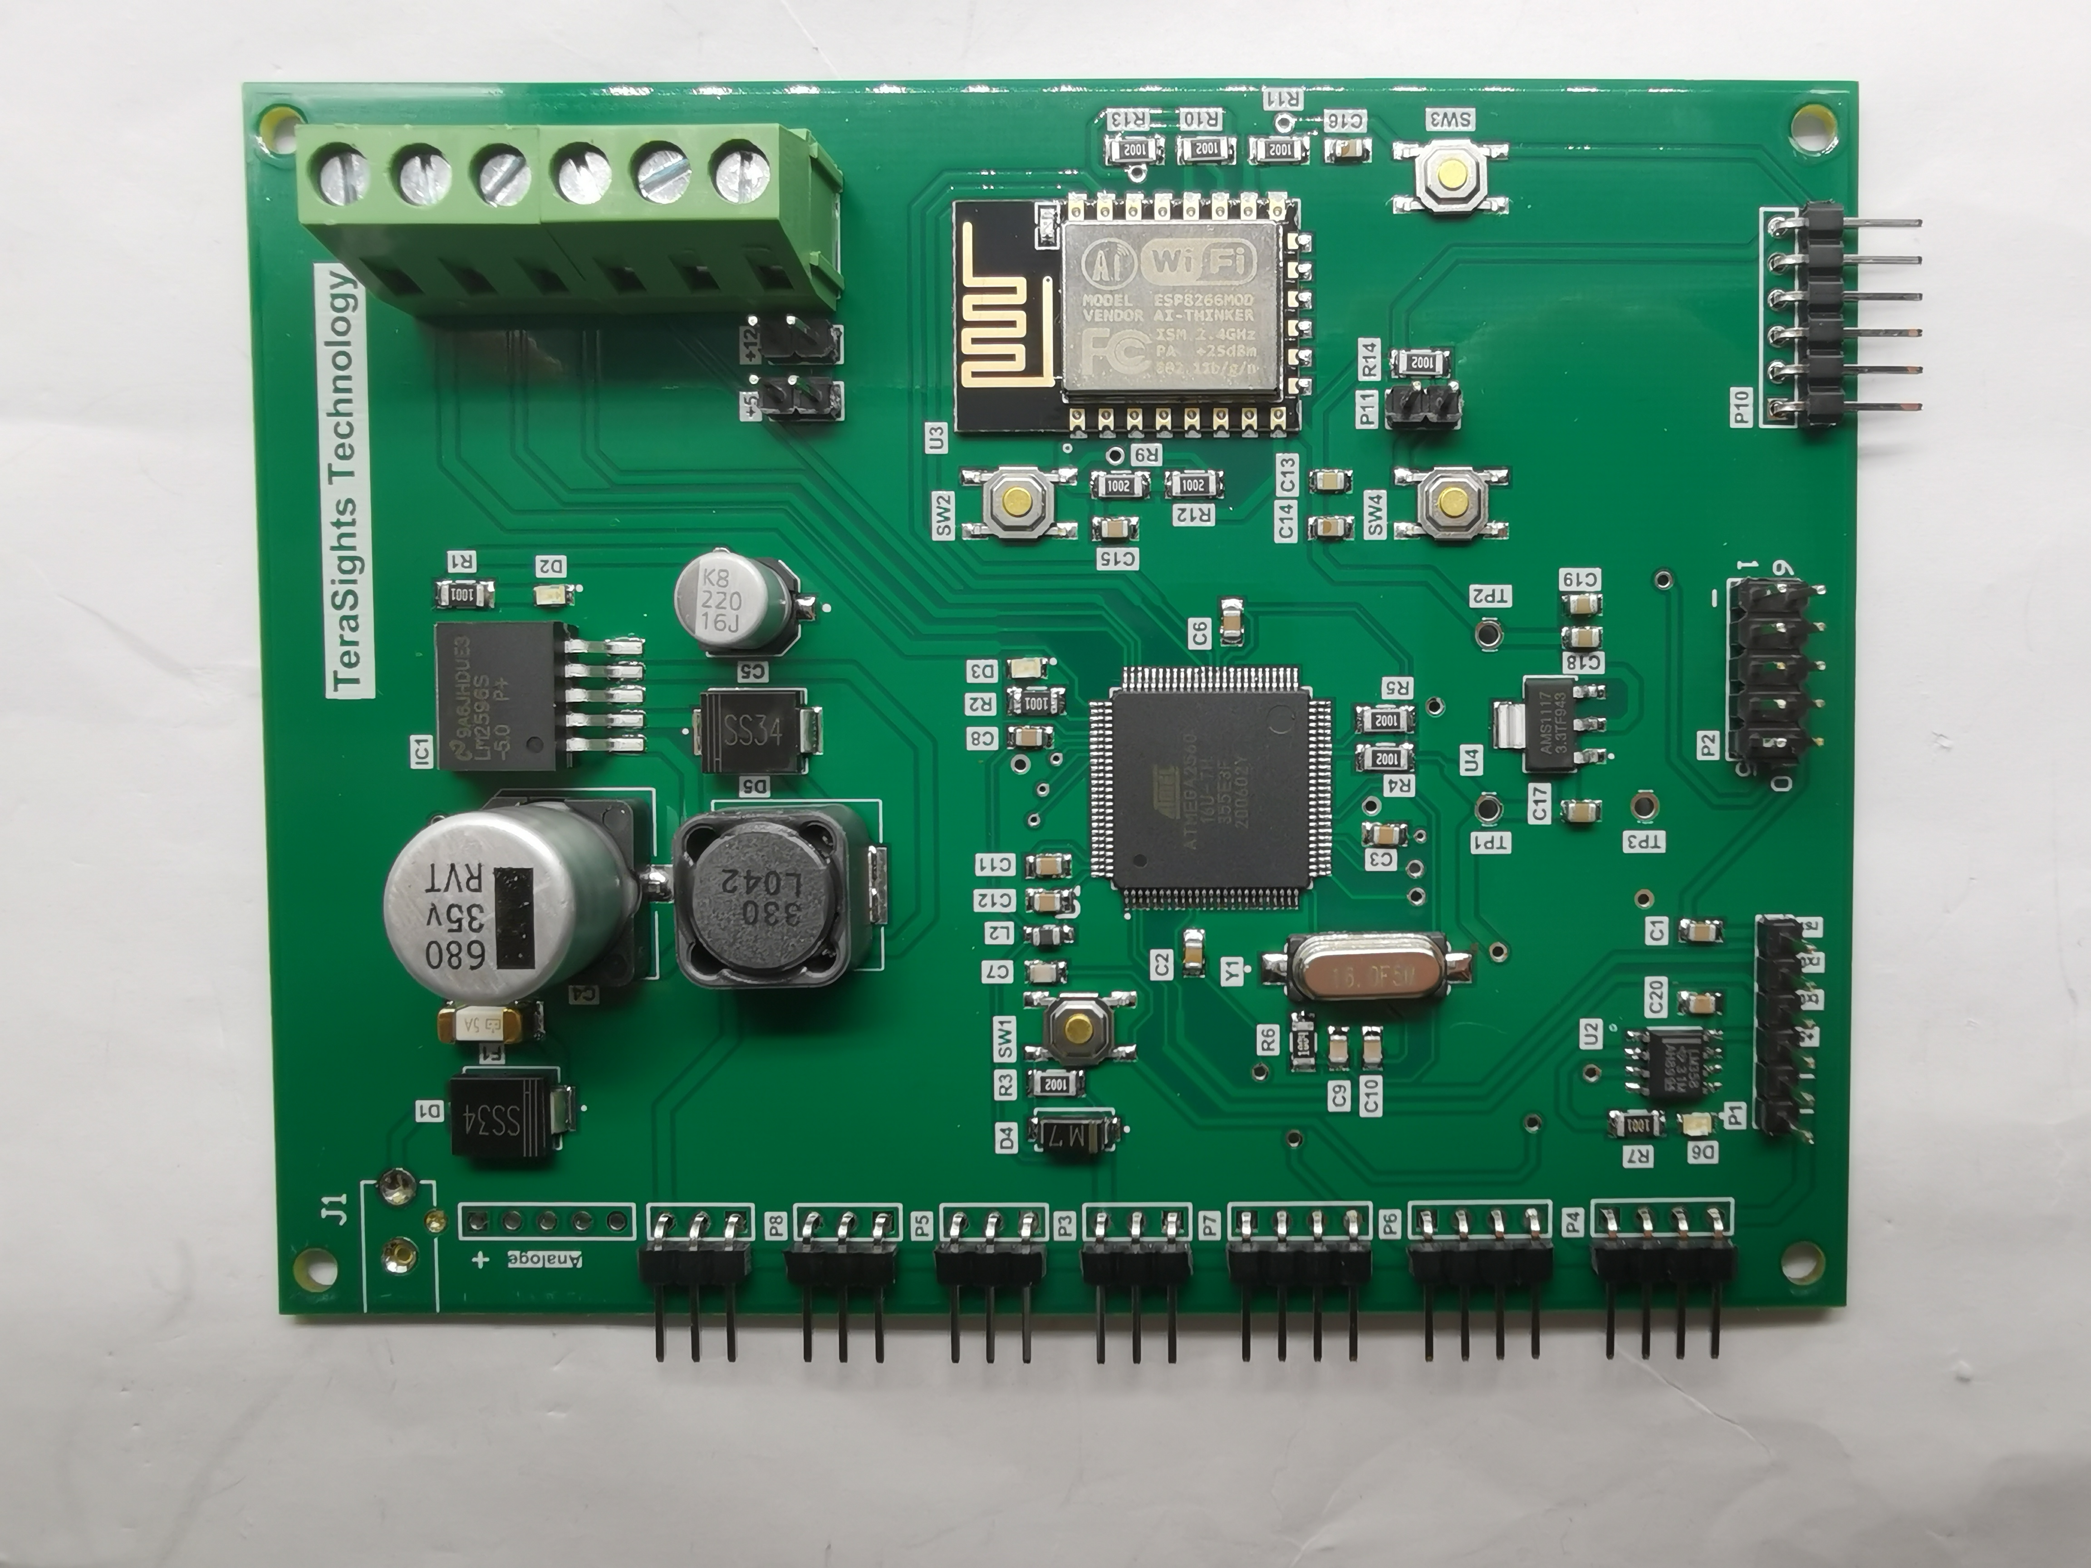
1 – IOT system
This circuit is considered as industrial kit for IOT systems .
It can treat with analog and digital signals .
Contain switched mode power supply hand made, esp8266 and ATMEGA 2560 .
It completely assembled in china.

Slide 3
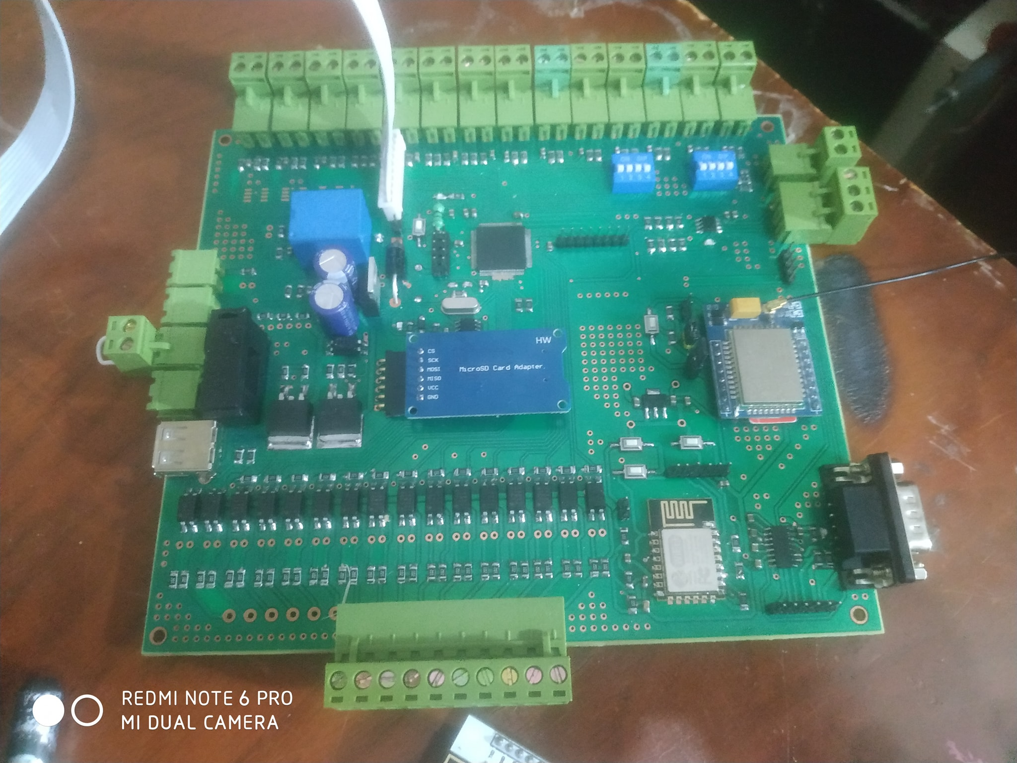
1 - Data logger circuit ( Feb. 2020 )
I made this kit to give a complete solution for all types of communication protocols like RS485, RS232, GPRS, and WIFI communication .
The kit contains 16 digital inputs, 16 analog input, backup power, and smart battery charger with the indications of battery levels.
The kit contain all types of protection like short circuit, reverse polarity, and ESD protection.
The kit is designed on ALTIUM designer program.

Slide 4

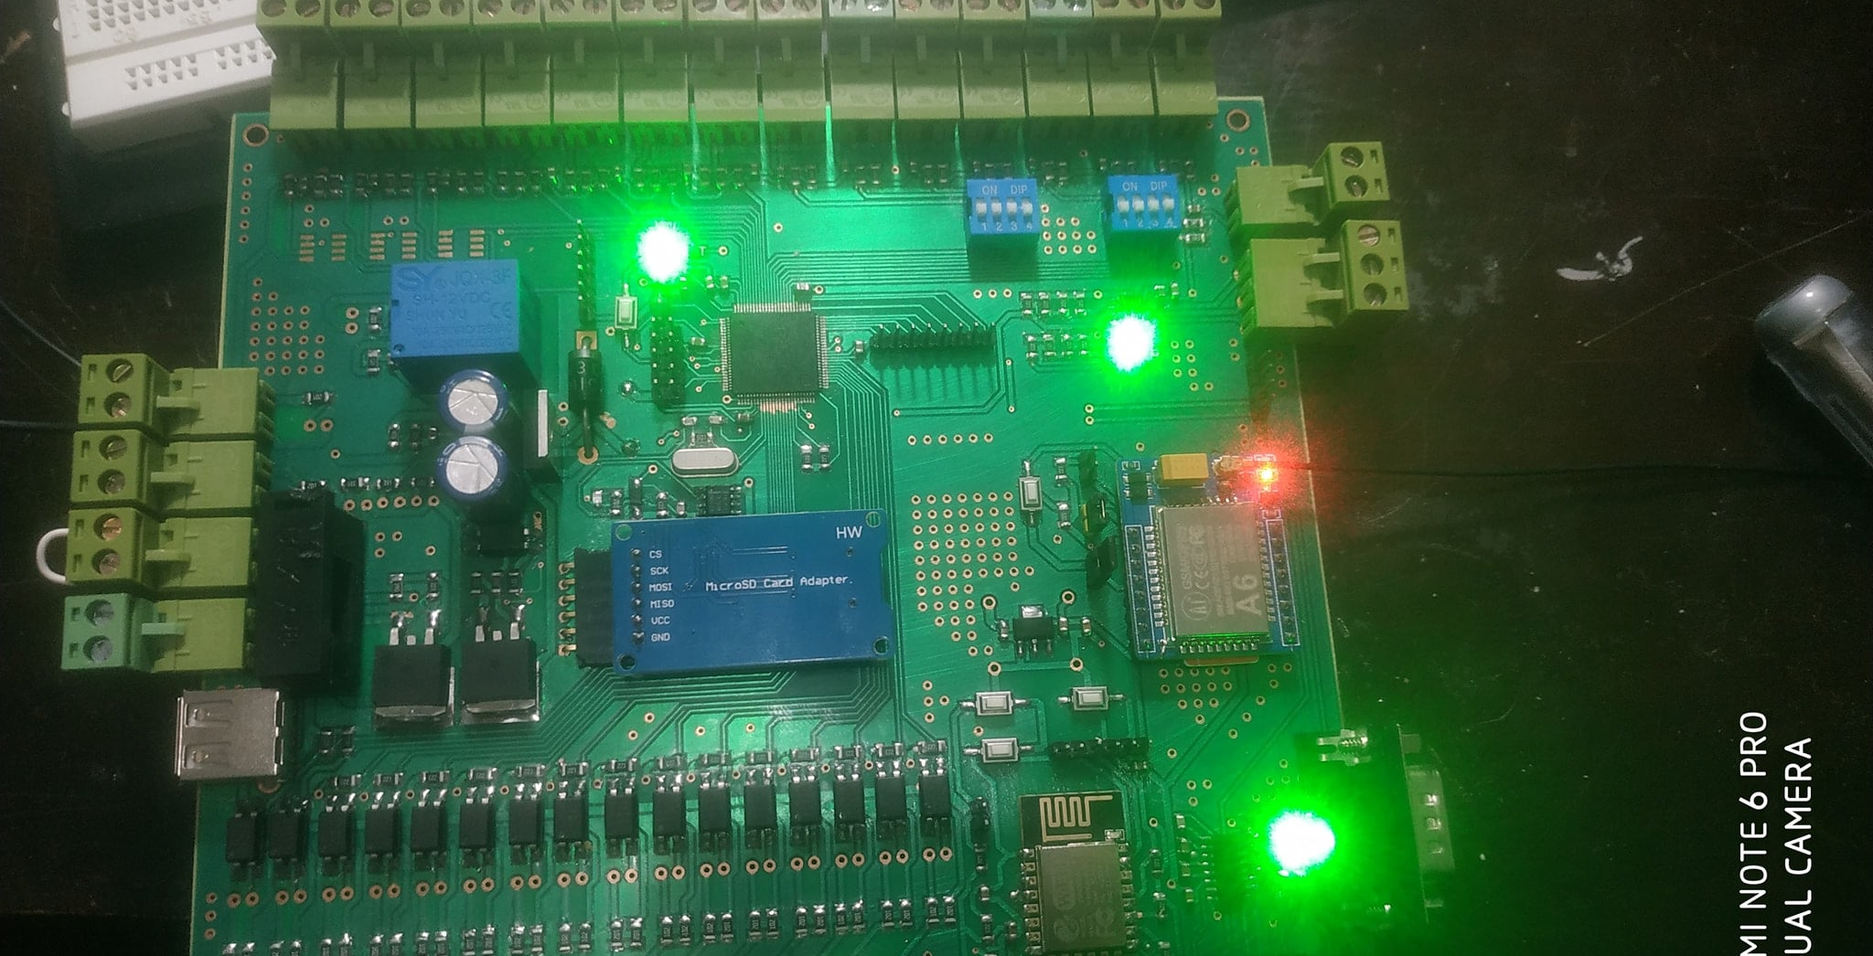

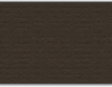

Slide 5
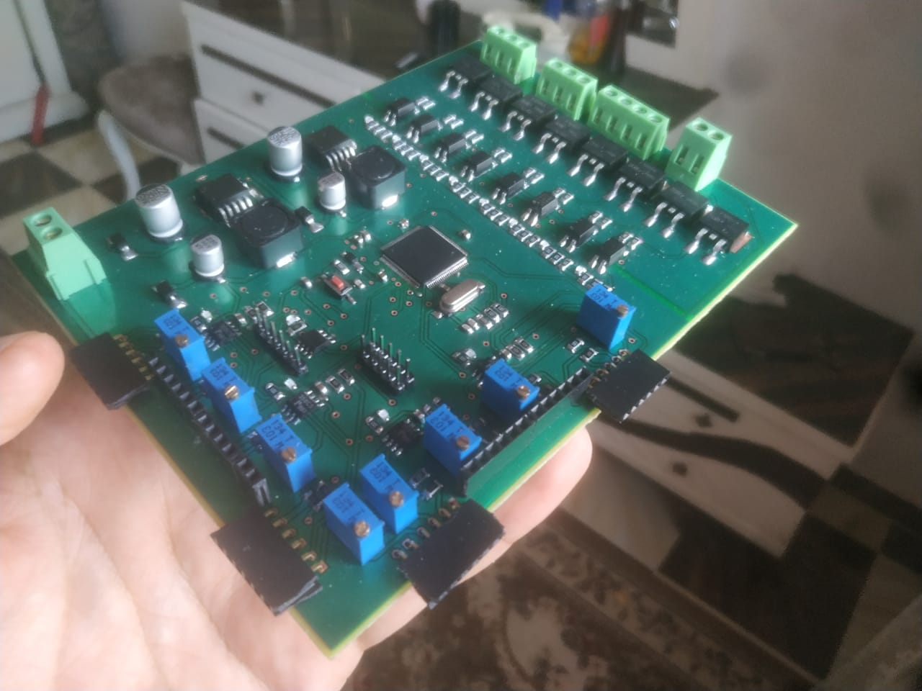
2 - contactless switches for elevator to overcome COVID-19 ( Jun. 2020 )
The circuit is designed so we can order floors in the elevator without touching the keys.
The kit is designed on ALTIUM designer program and programmed with Arduino IDE.

Slide 6
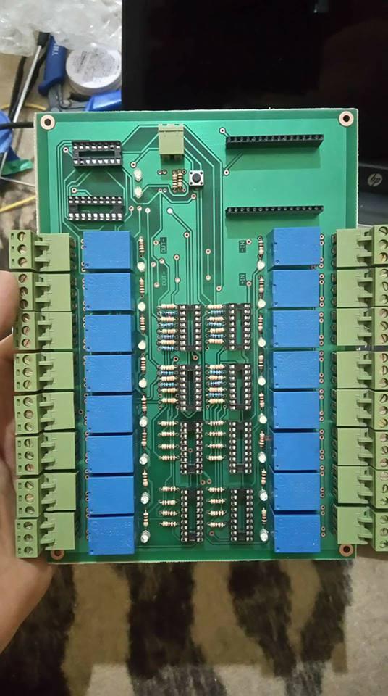
3 – Smart home system with 16 loads ( Jun. 2020 )
This circuit depends on the esp8266 WIFI module and you can control 16 devices with it .
The kit is designed on ALTIUM designer program and programmed with Arduino IDE.

Slide 7
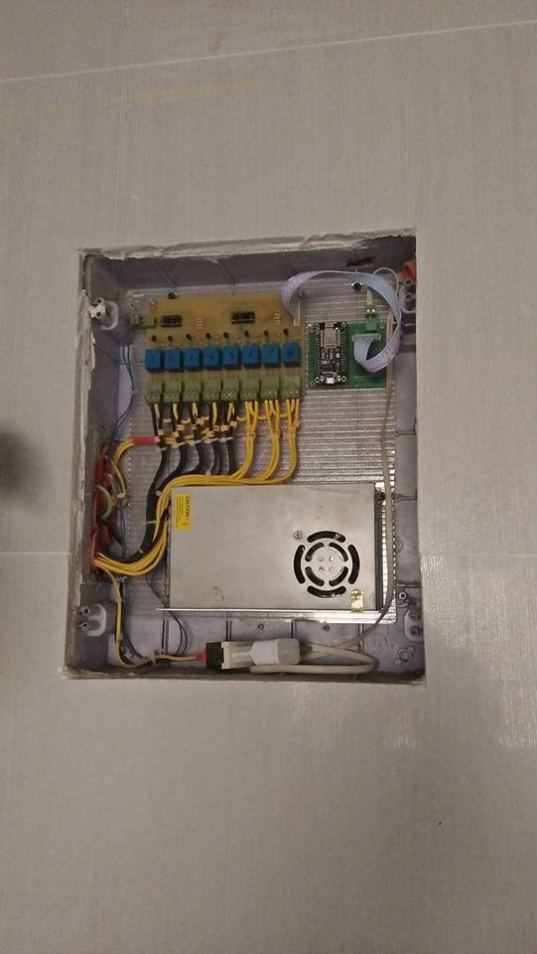
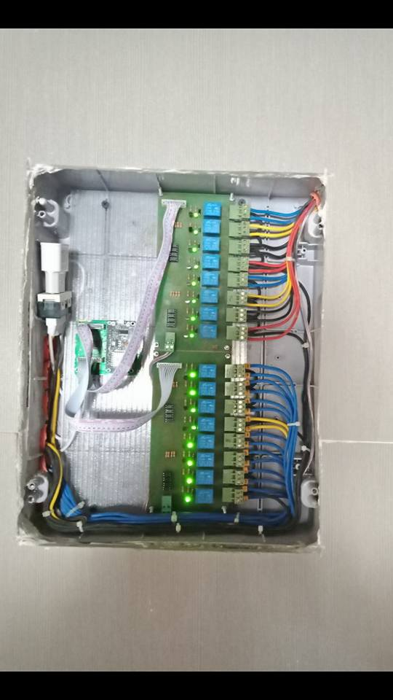
4 – Smart home system with 16 loads SMD ( Feb. 2020 )
This circuit depends on the esp8266 WIFI module and you can control 16 devices with it .
The kit is designed on ALTIUM designer program and programmed with Arduino IDE.

Slide 8
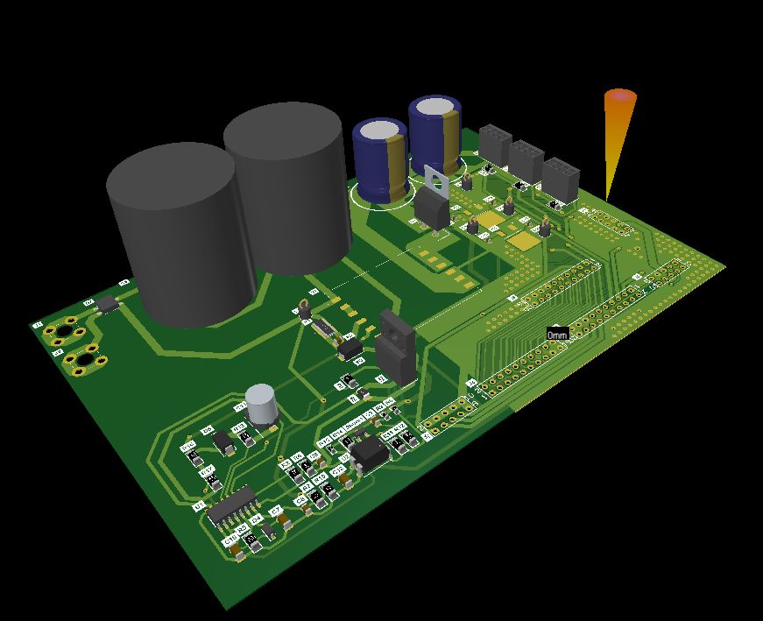
5 – Switched Mode power supply (Nov. 2019)
The circuit is designed on ALTIUM designer.

Slide 9
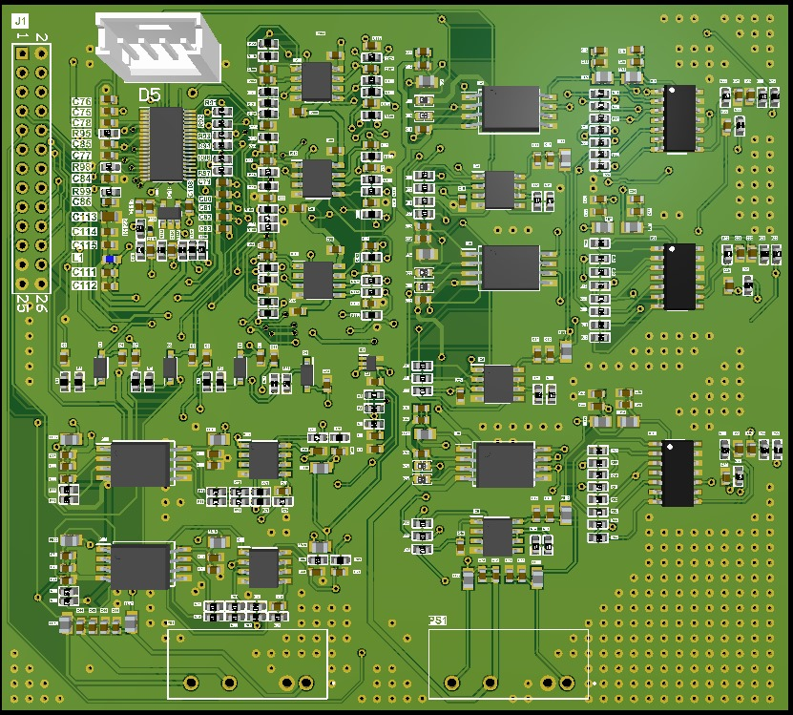
6 – DC power converter control (Jul. 2019)
The circuit is designed on ALTIUM designer.

Slide 10
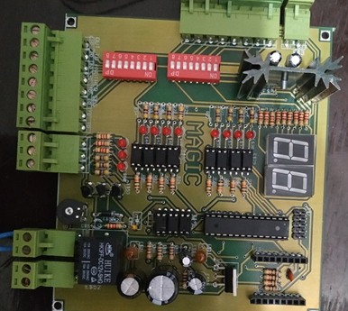
7 – Complete sound system for elevator (Mar. 2019)
This circle can tell us the floor number where the elevator is located and tell the users to avoid the elevator in case of emergency work.
The circuit is designed on Autodesk EAGLE and programmed using MICRO C program.

Slide 11
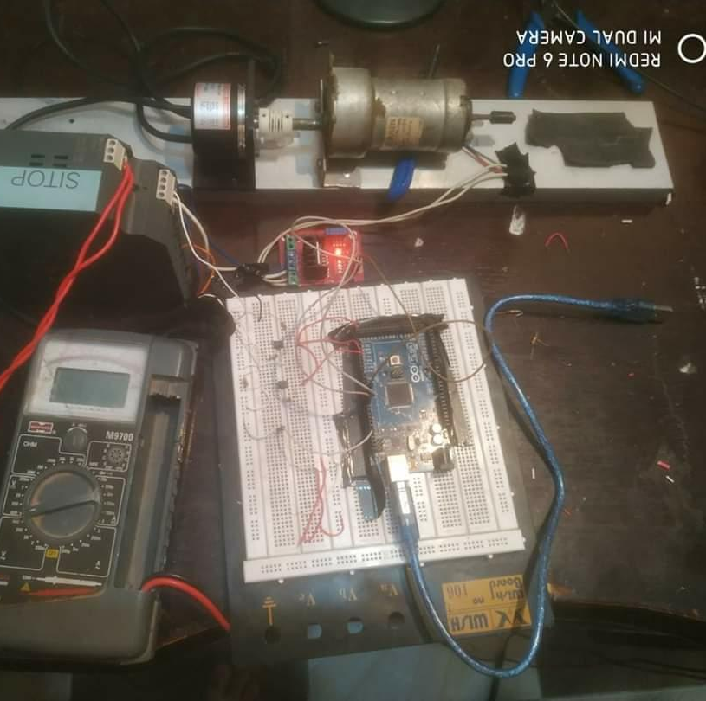
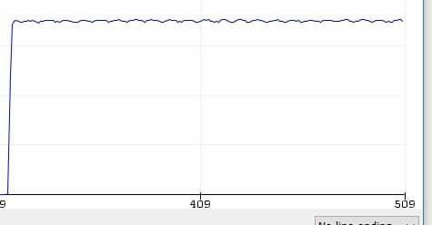
8 – Modular and Robust PID algorithm (Feb. 2019)
This a modular and robust PID controller applied on DC motor with quadrature encoder .
The algorithm is developed without using any library form the Arduino library.

Slide 12
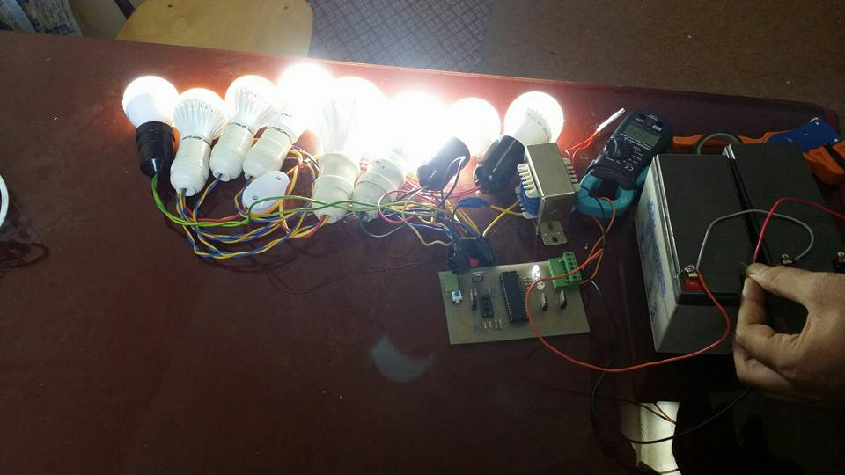
10 – power inverter for solar cell (Oct. 2018)
This is 250 watt for solar cell and the circuit contain a smart charging techniques for batteries.
The circuit is designed using EAGLE and programmed using MICRO C software.

Slide 13
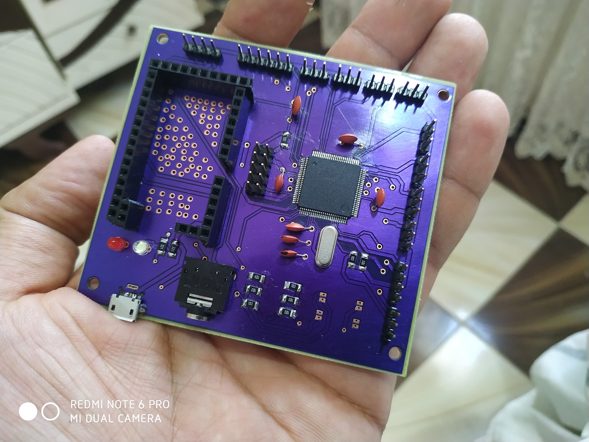
11 – control things using A9G GSM/GPRS (Jul. 2018)
This circuit use A9G GSM with ATMEGA 2560 to control loads from any place .

Slide 14
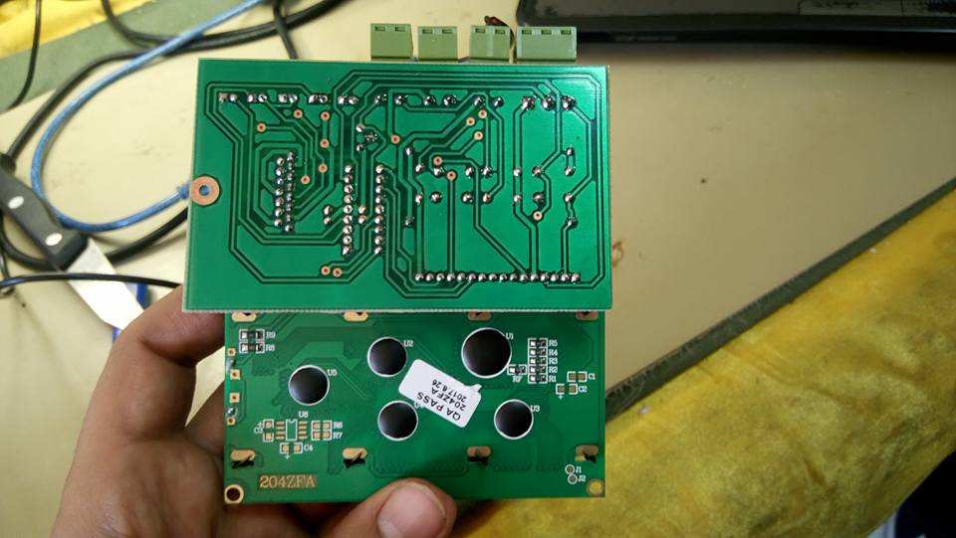
12 – Electronic circuit to control a medical chair (Mar. 2018)
This circuit is used in physical therapy devices.
The circuit is designed on ALTIUM designer.

Slide 15
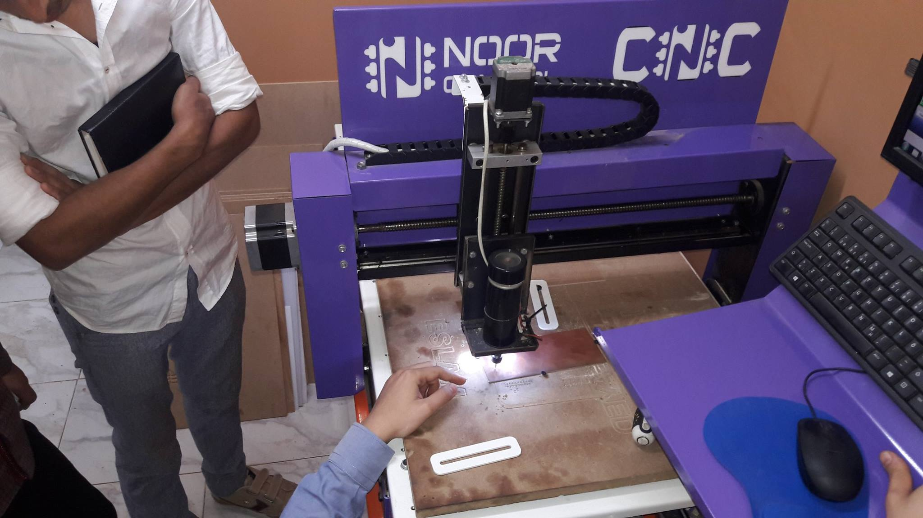
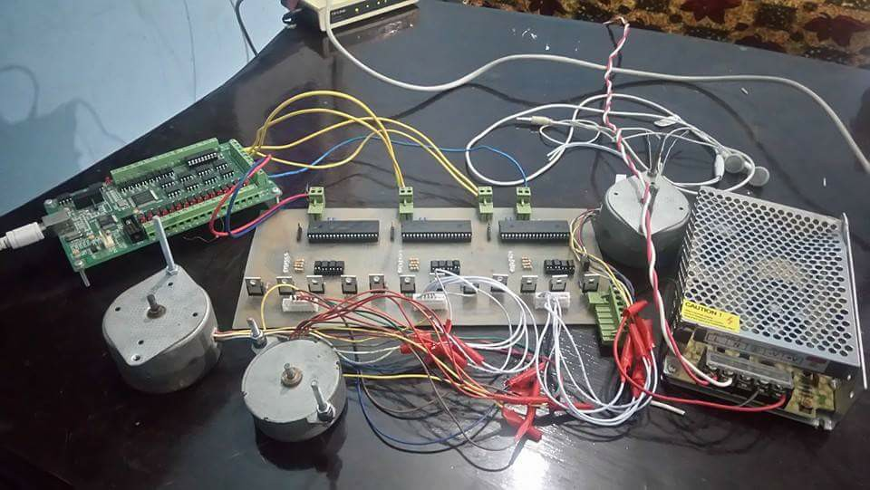
13 - CNC machine for fabricating printed circuit board
This my graduation project I construct all control circuit by myself .
The drivers circuit I add to it a new way to controlling stepper motor by a smoothly way.

Slide 16
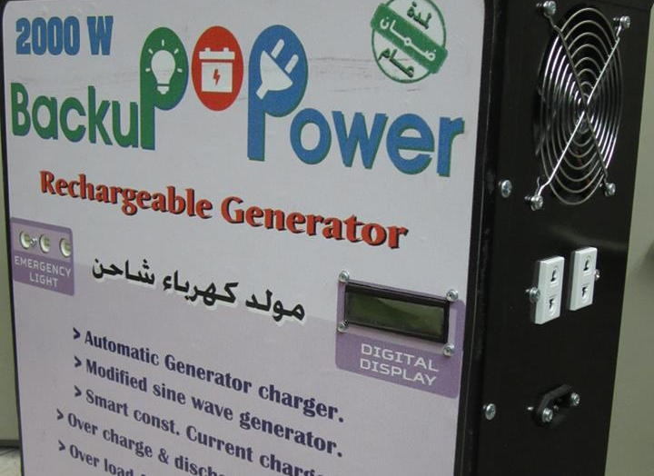
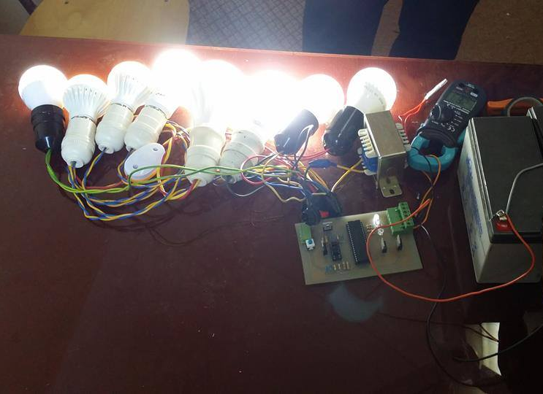
14 - Power inverter using microcontroller
I design this device for solving the problem of electricity cut off in a far region .
This device is more efficient than another come from other country because it has a constant current constant voltage charger and more safety options.

Slide 17
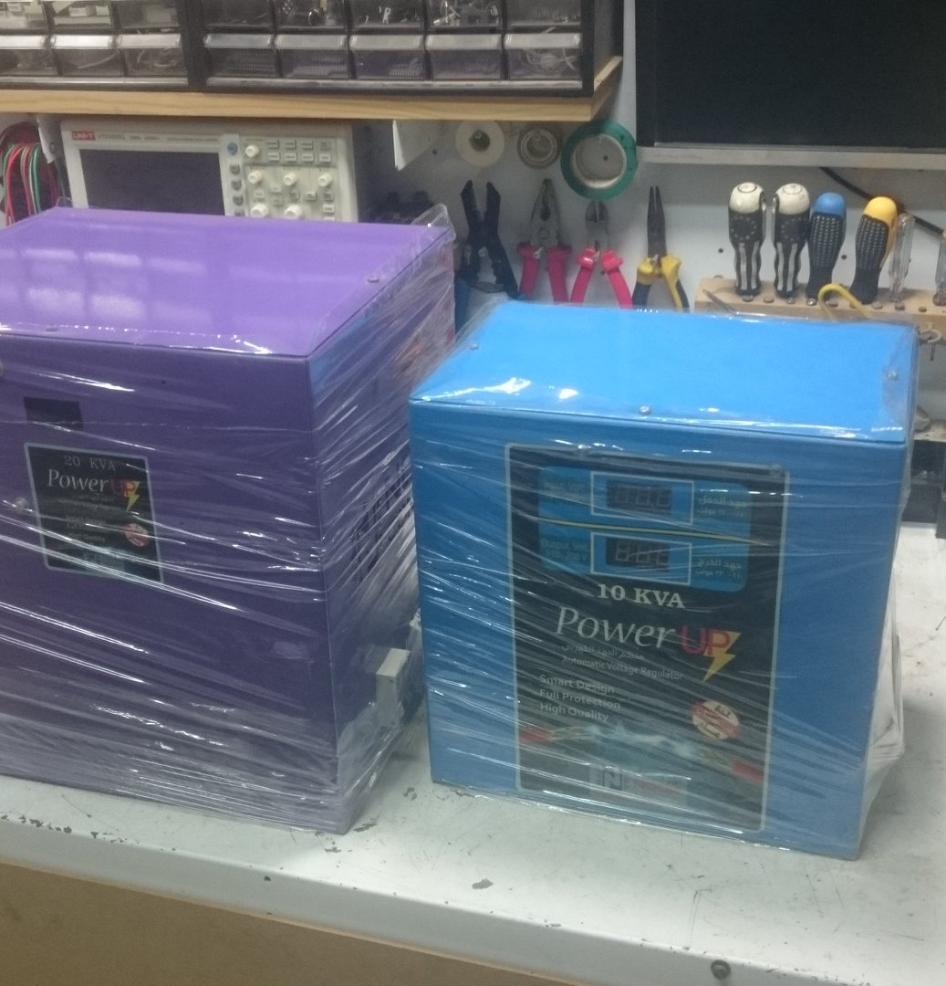
15 - Stabilizer device for regulating electricity.
I made this device for regulating electricity in a region that have a very little electricity because little electricity is very dangerous for more devices.
This device has a protection from excessive electricity and have a delay protection .

Slide 18
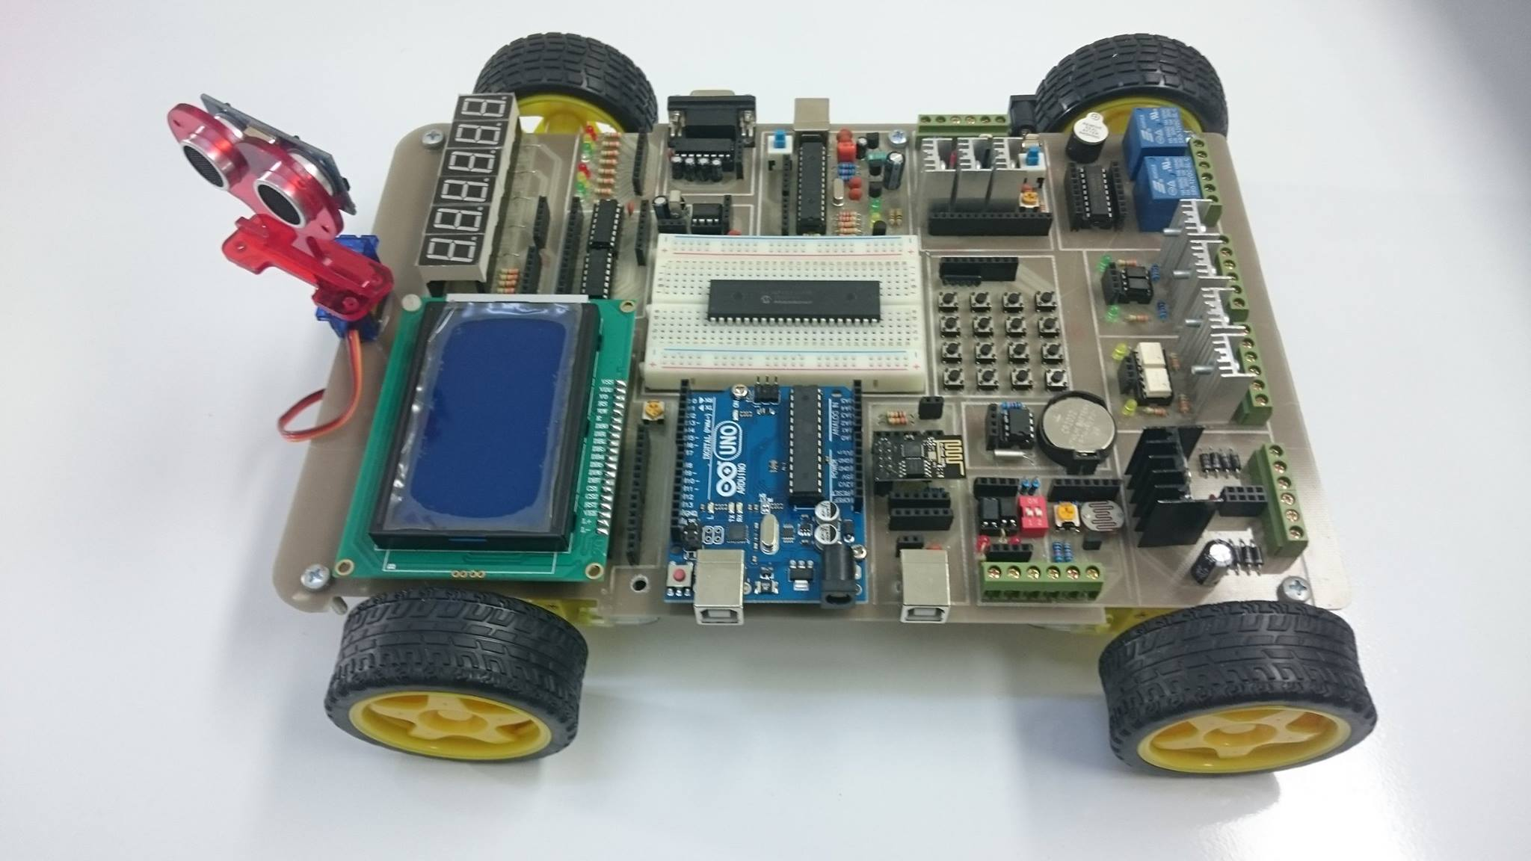
16 - Embedded learning kit AVR , PIC , Arduino and ARM
This is a learning kit I designed it to simplify the learning of Embedded system to programmers.
It contain more modules and interfaces and you can control it by PIC or Arduino or ARM or AVR.

Slide 19
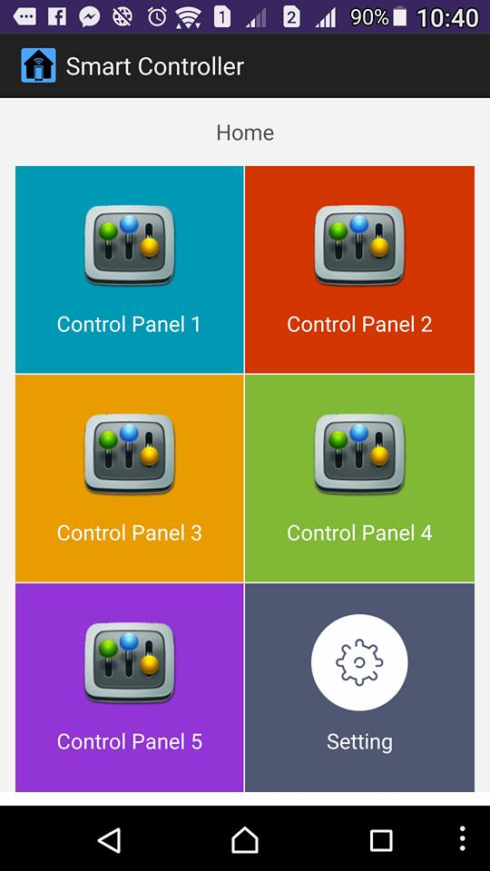
17 - Smart home system for controlling many devices .
This system can control anything inside your home from anywhere.
You can know how many devices is run inside your flat at any time .

Slide 20
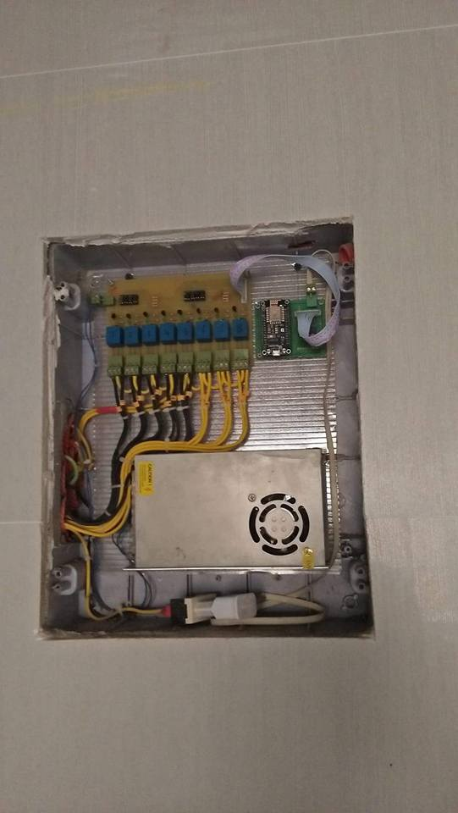
18 - Smart home system for controlling many devices .
This system can control anything inside your home from anywhere.
You can know how many devices is run inside your residence/ company/ … etc.

Slide 21
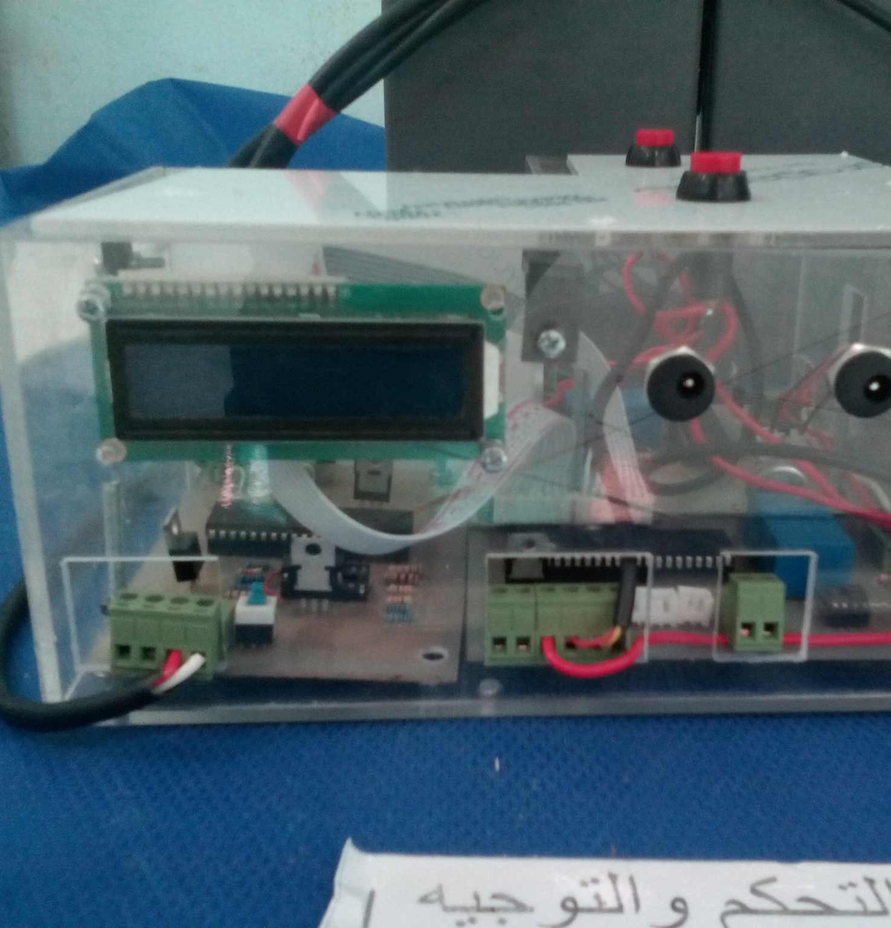
19 - A constant current/constant voltage charger for batteries.
This device I made it because this way of charging save the battery long life and when battery charging it not warm yet.

Slide 22
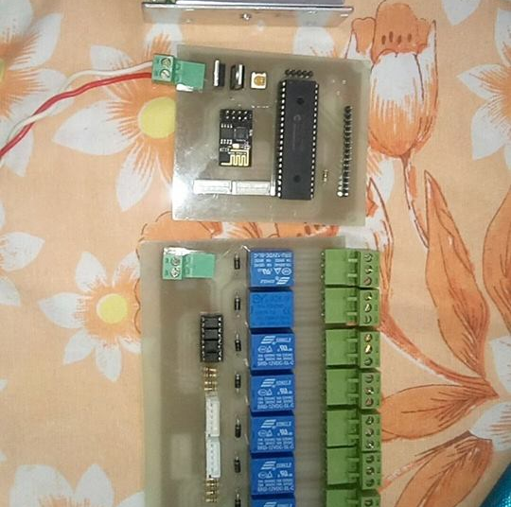
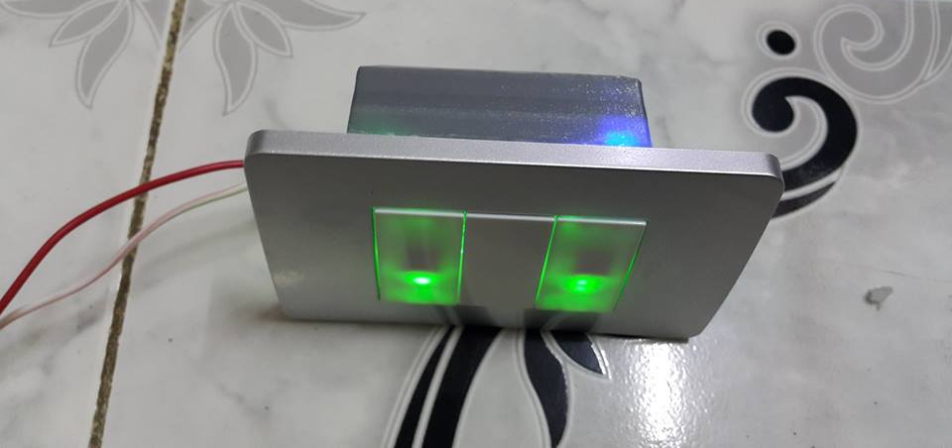
20 - Smart touch switch
This circuit I designed it to made a life is easy it convert any switch to touch and you can control on or off to this switch by mobile from anywhere in the world .

Slide 23
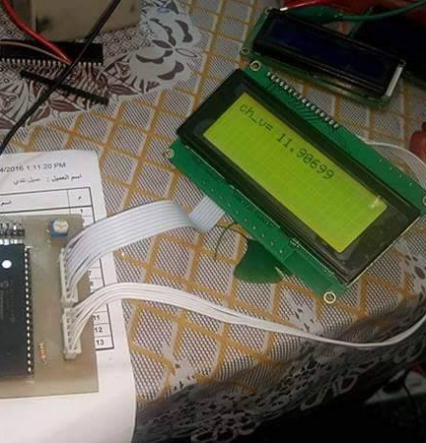
21 - PWM controller for solar cell system
I made this device to obtain a power from the solar cell at sunset and the circuit regulate the optimum power for charging the battery connected to the solar .

Slide 24
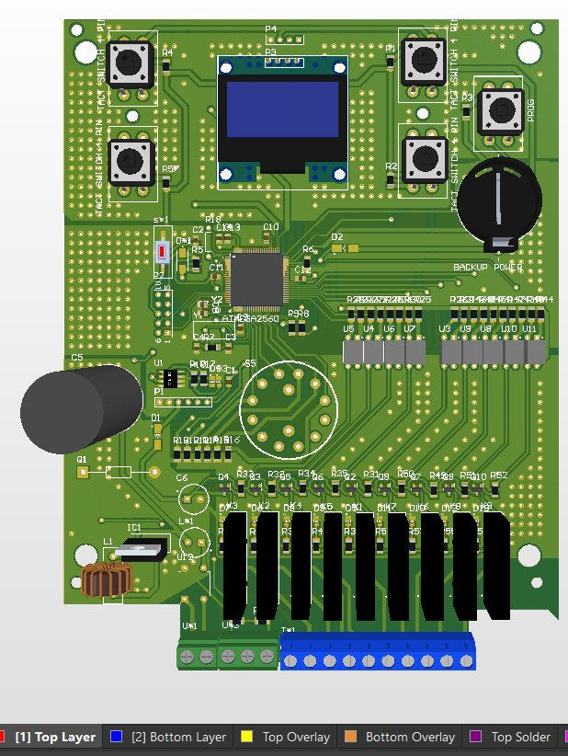
23 - Tracking system for solar cell system.
This system can track a the sun to obtain the maximum power from sun .

Slide 25
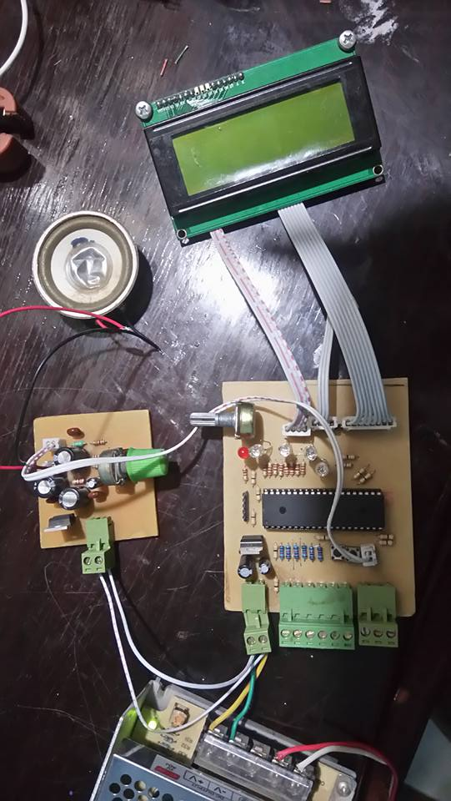
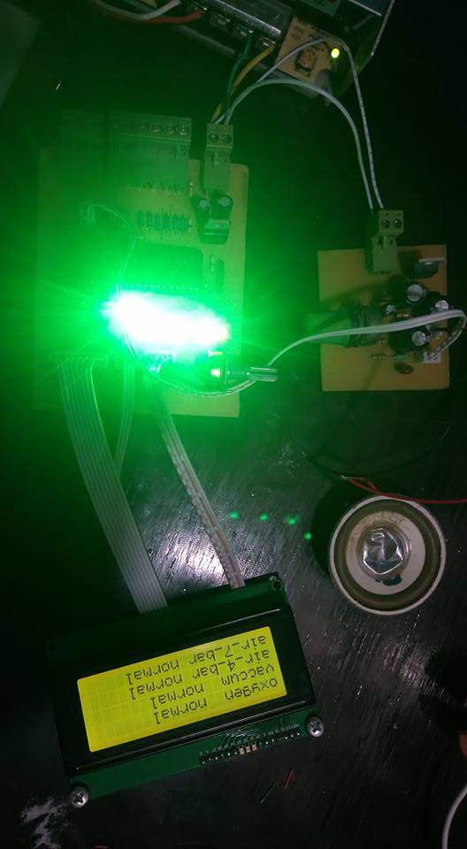
24 - Gas pressure alarm device for hospital.
This device can detect the error in any line of gas in hospital and when this error is eliminated ,it give me a feed back and has a sound system also .

Slide 26
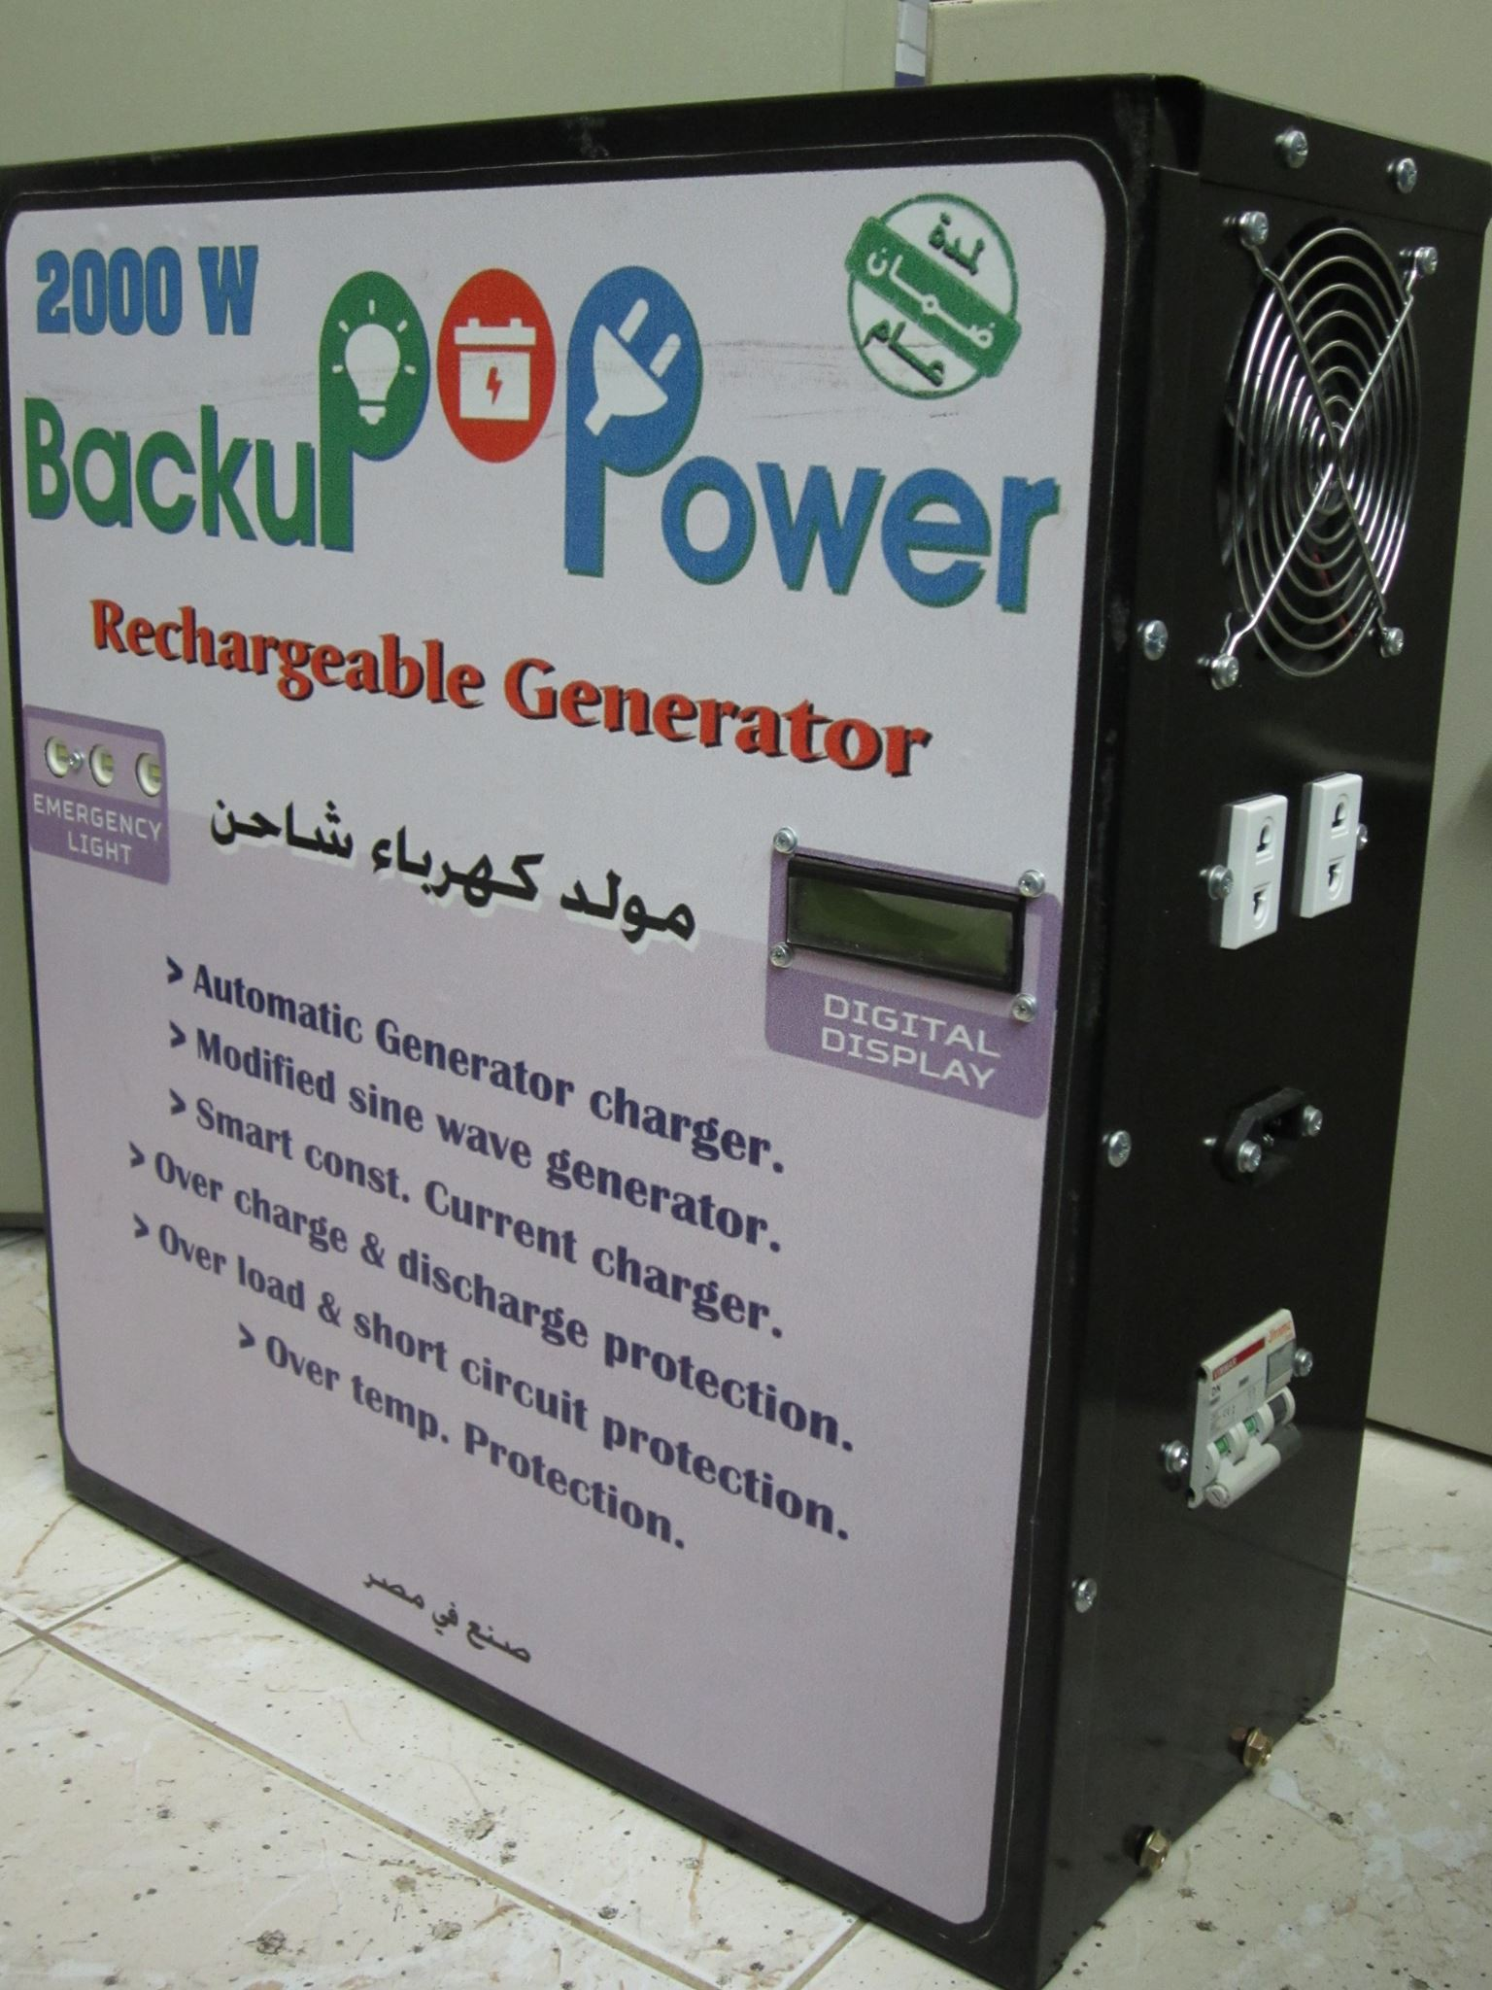

Slide 27
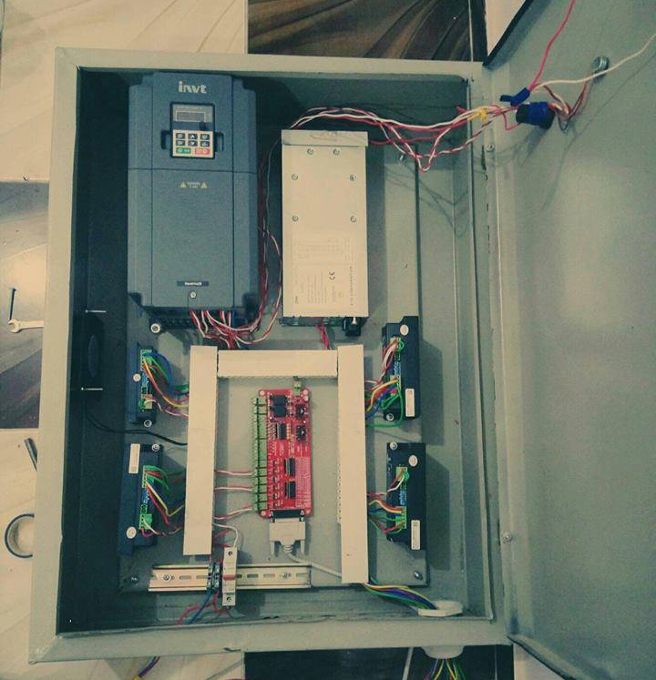

Slide 28
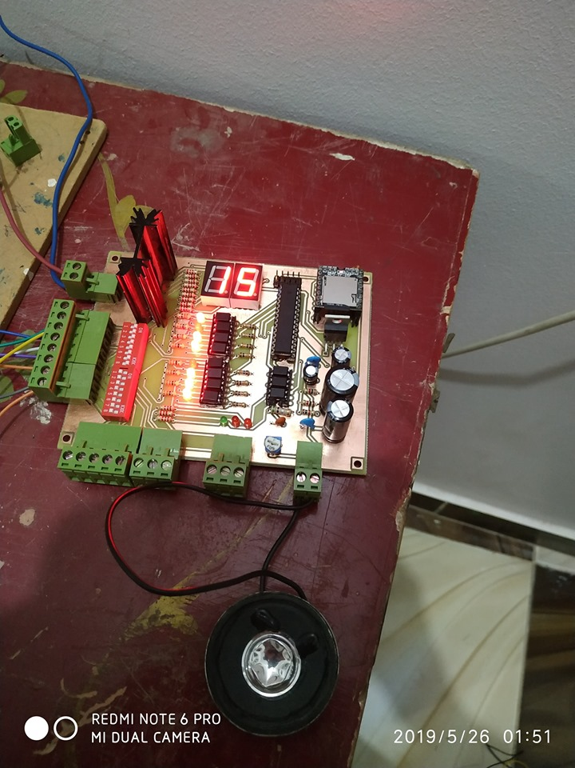
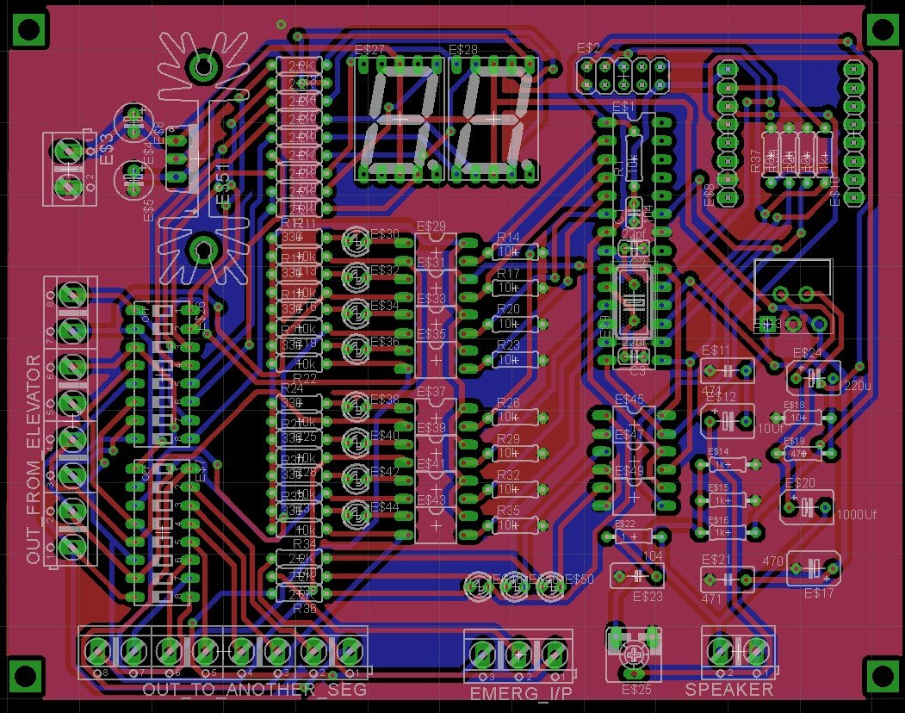

Slide 29
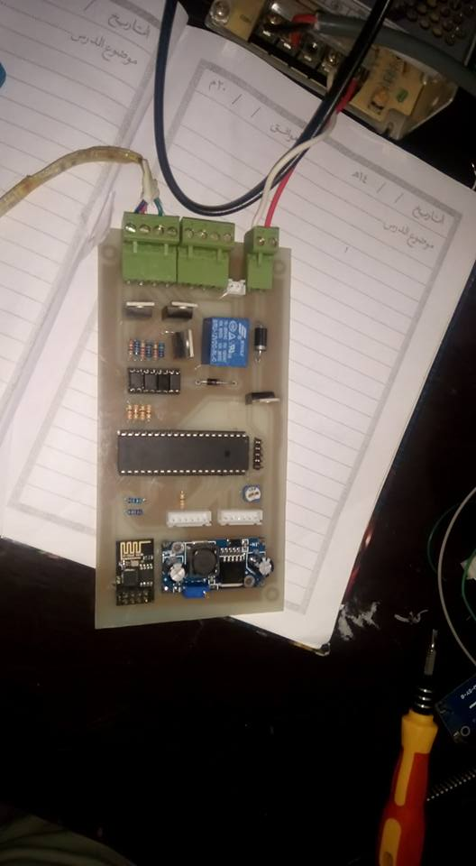
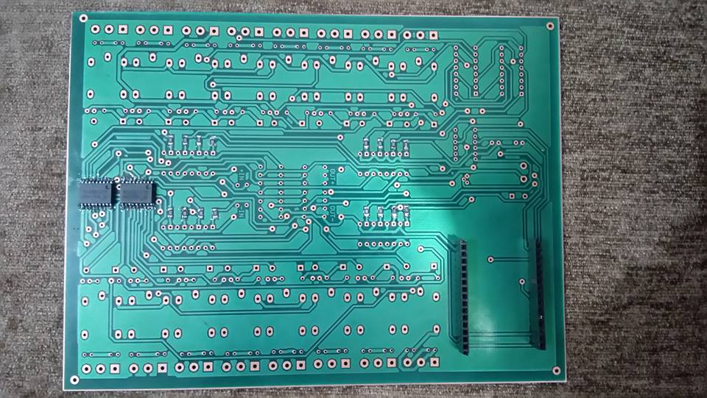

Slide 30
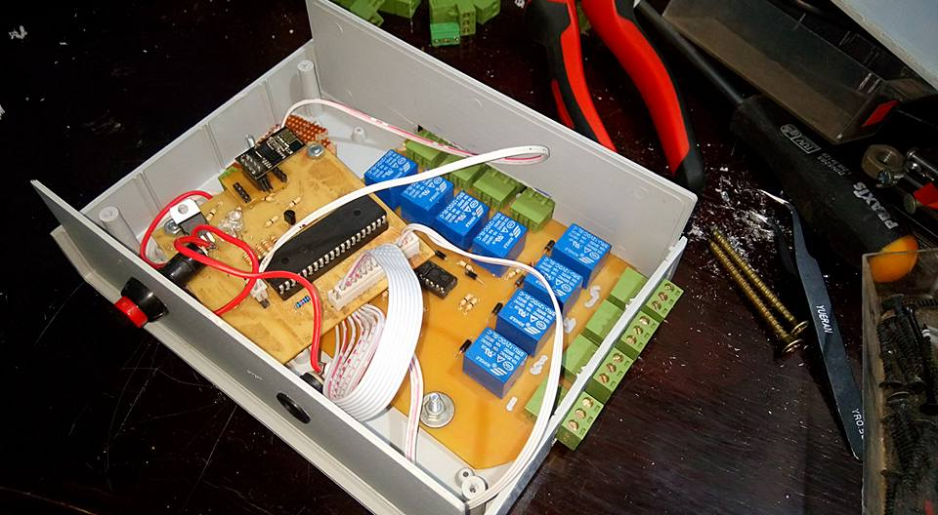

Slide 31
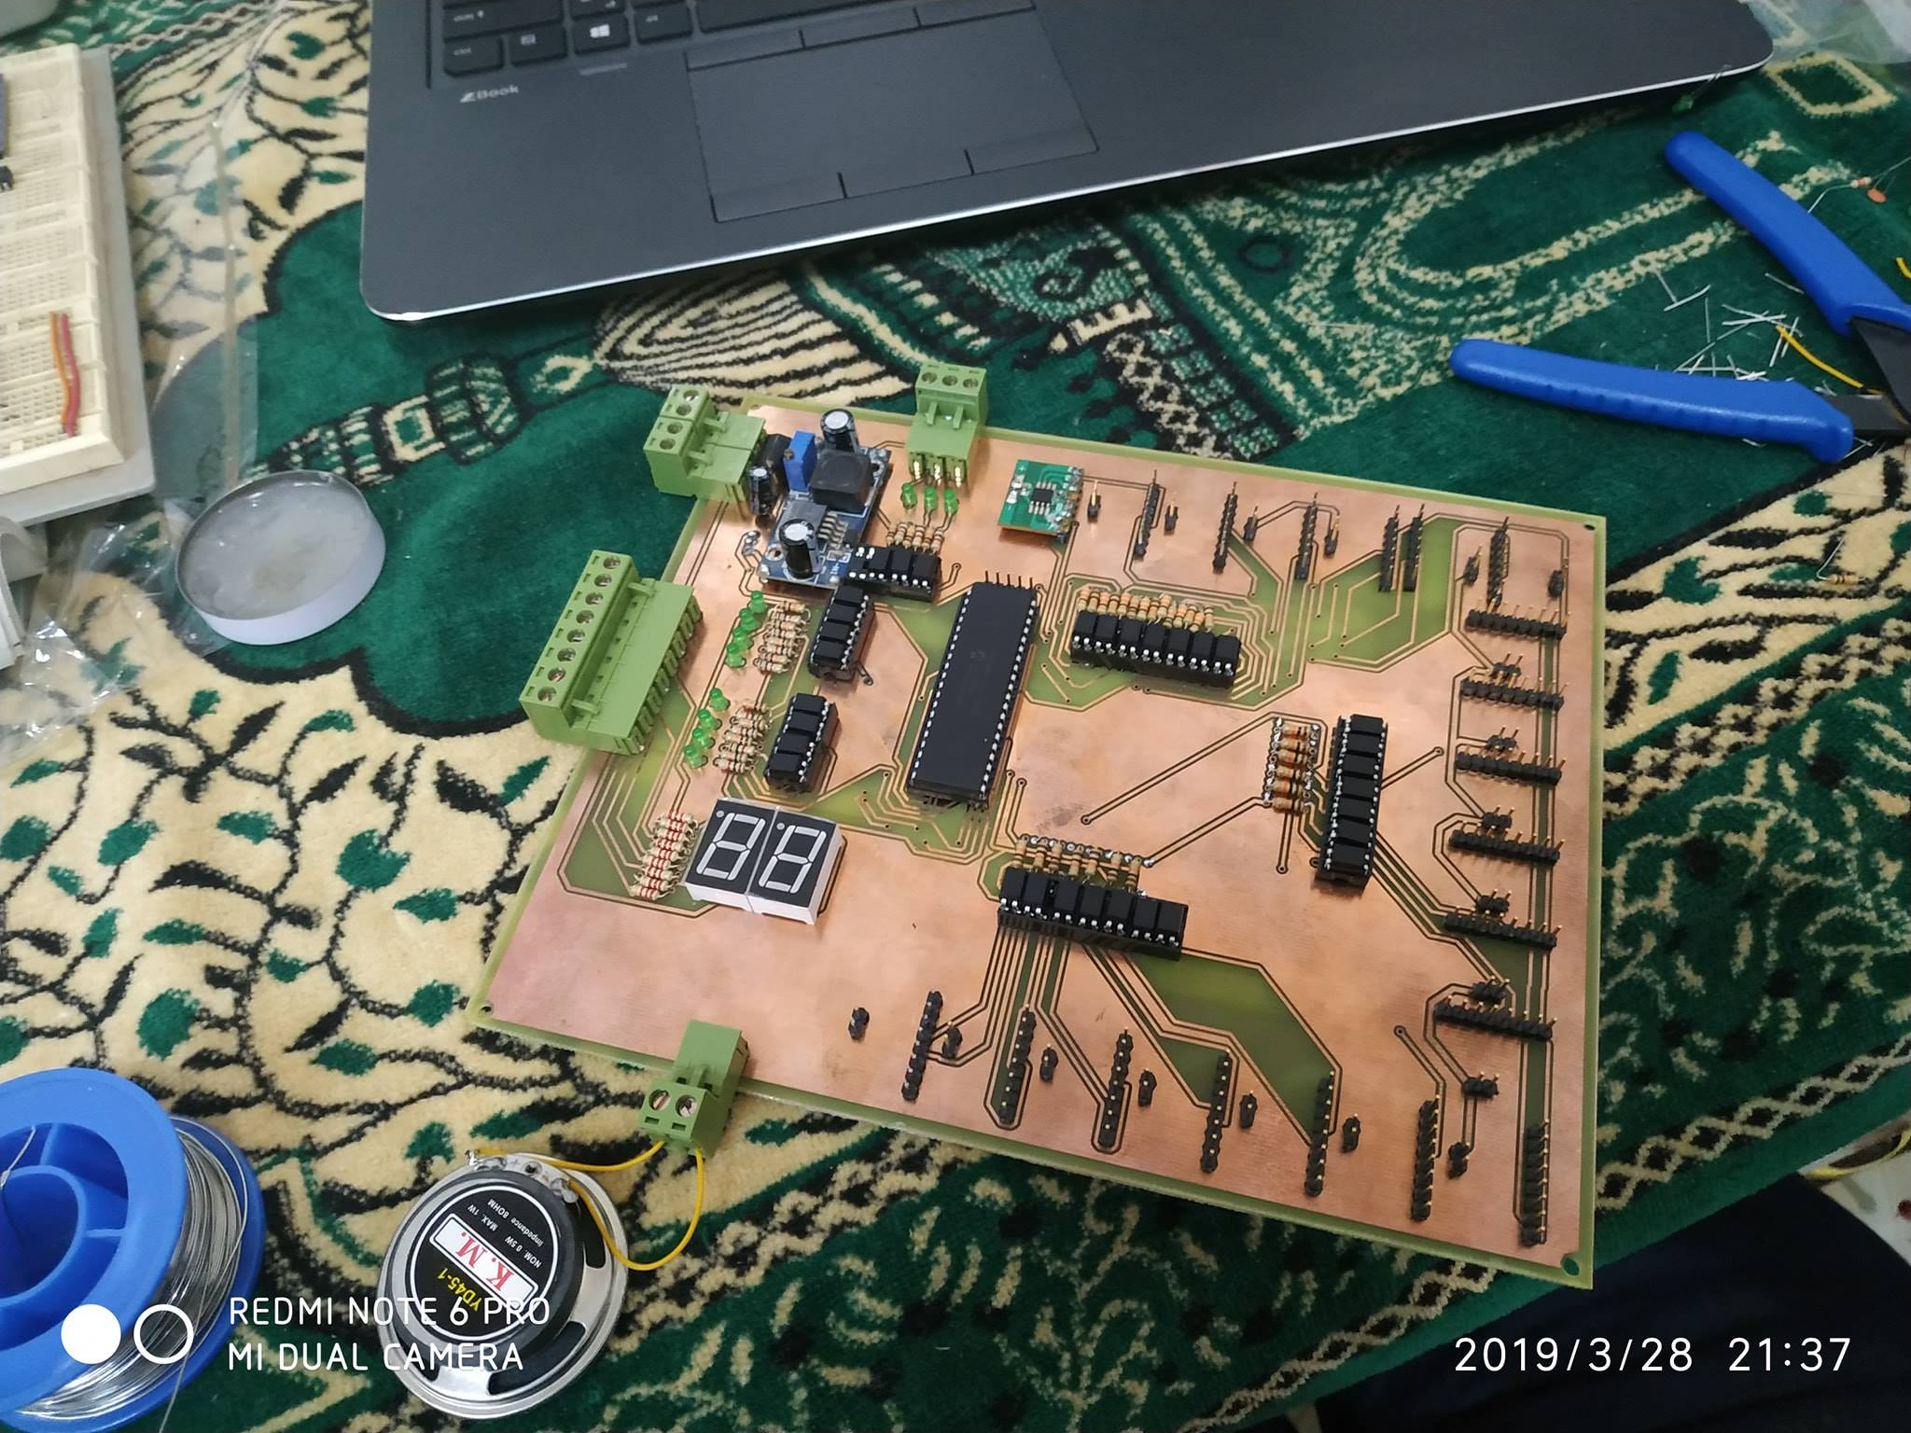

Slide 32
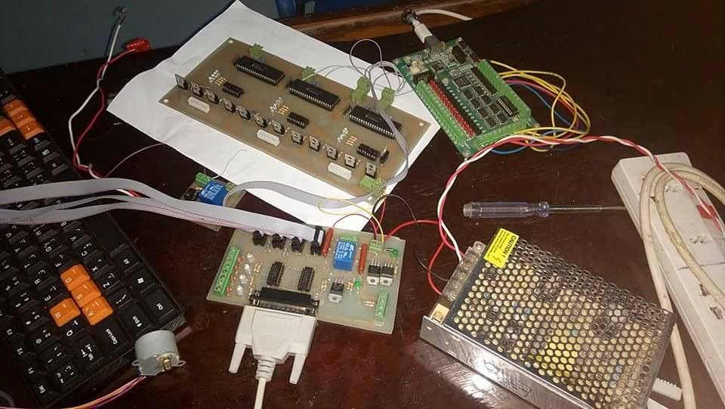
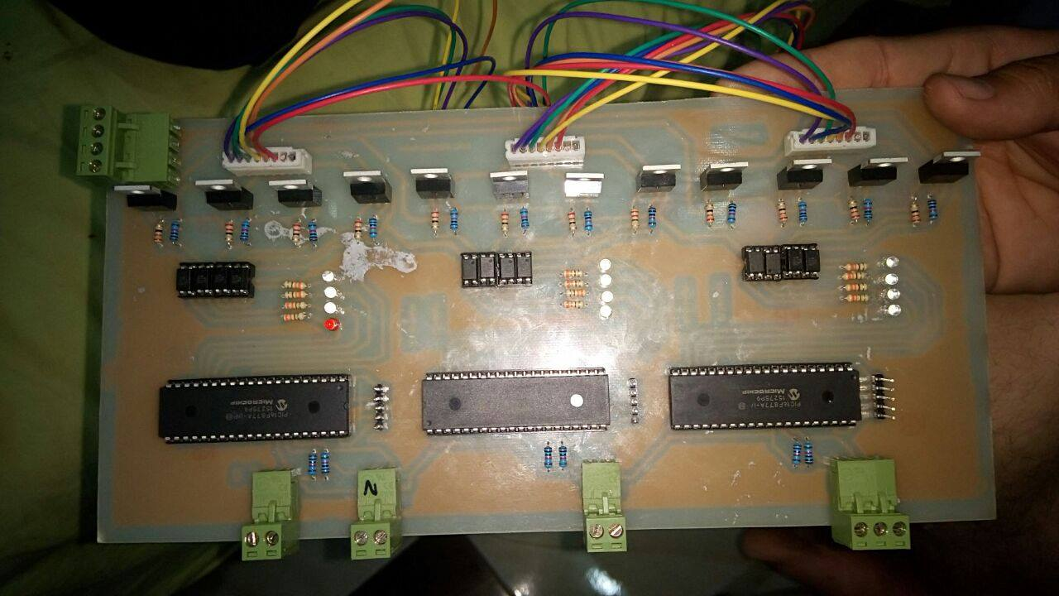

Slide 33
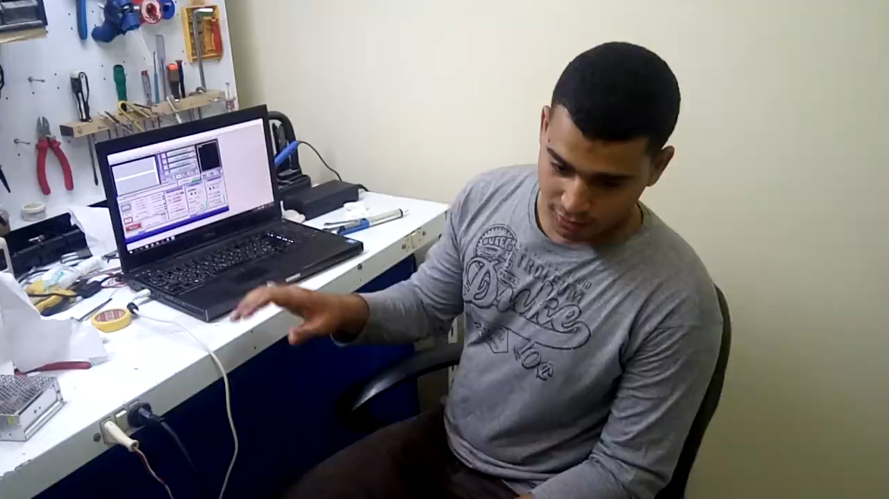

Slide 34
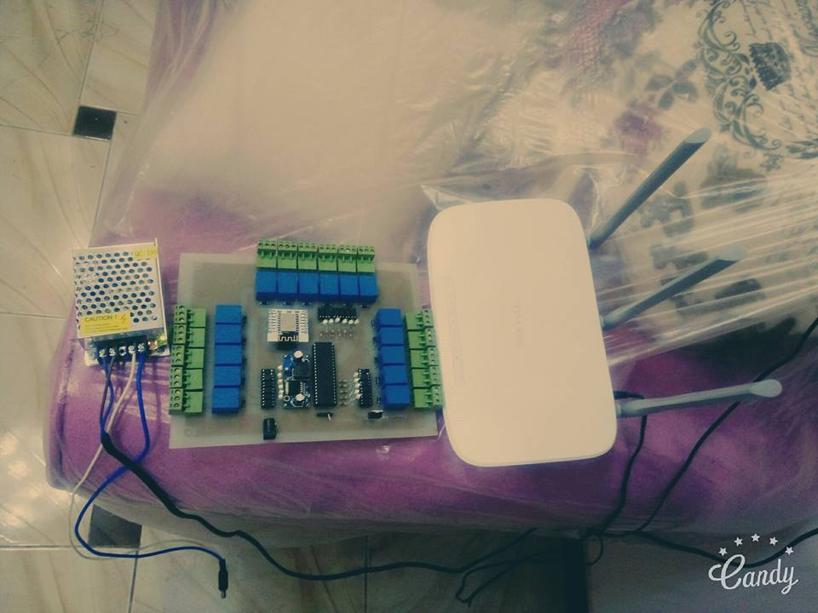
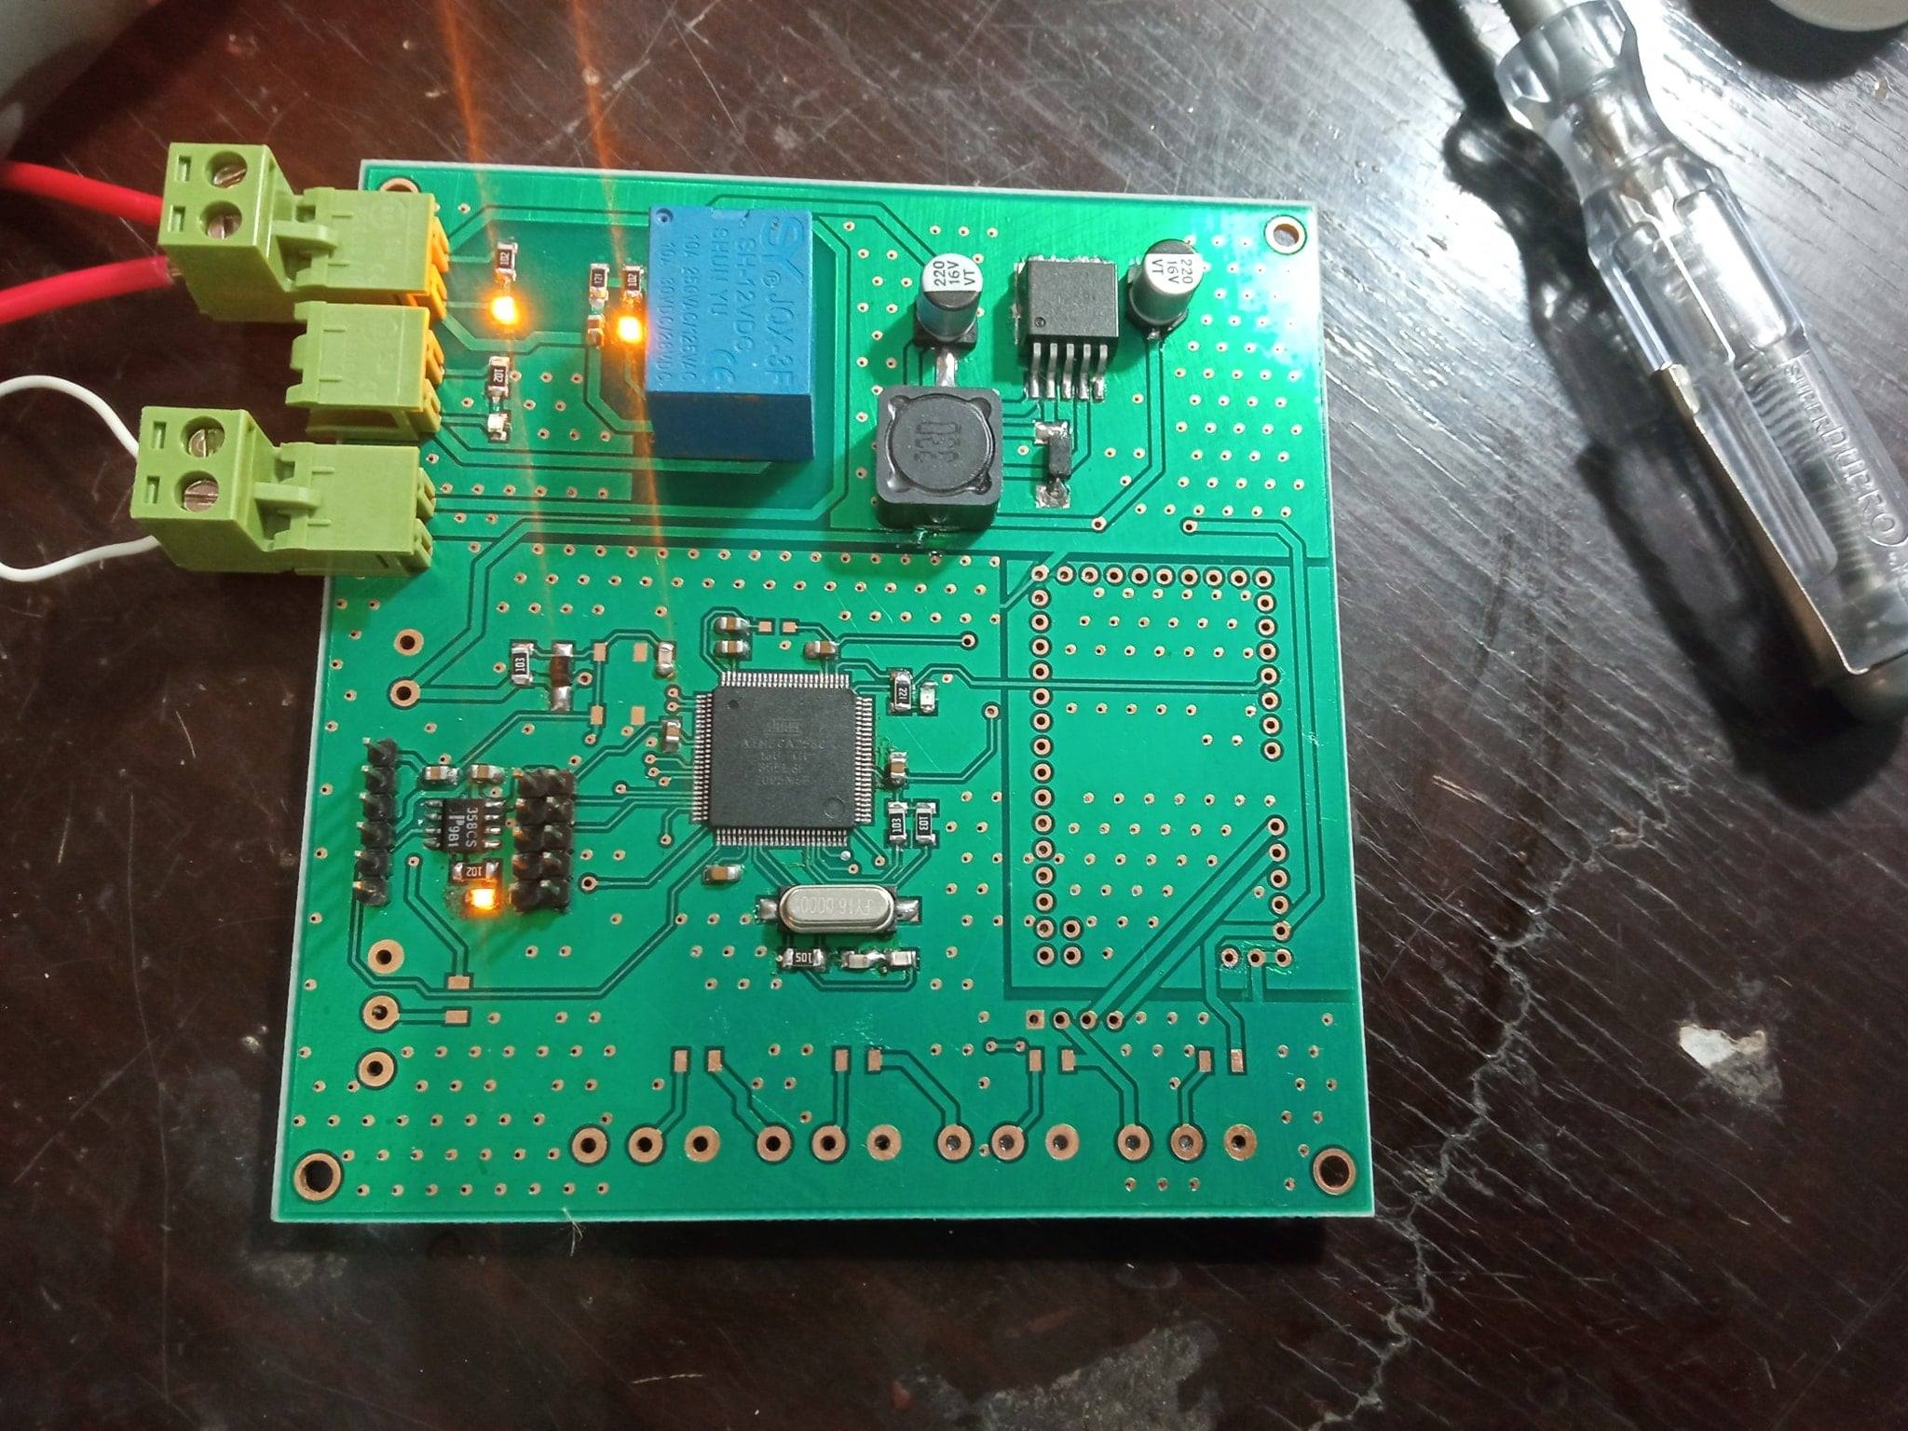

Slide 35
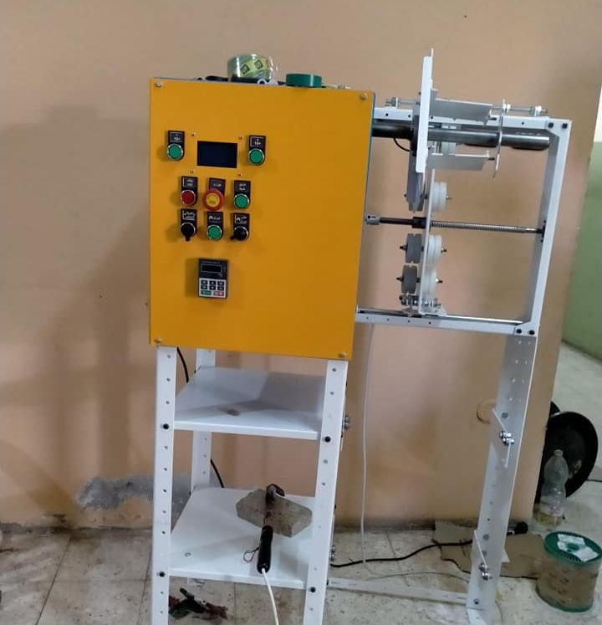
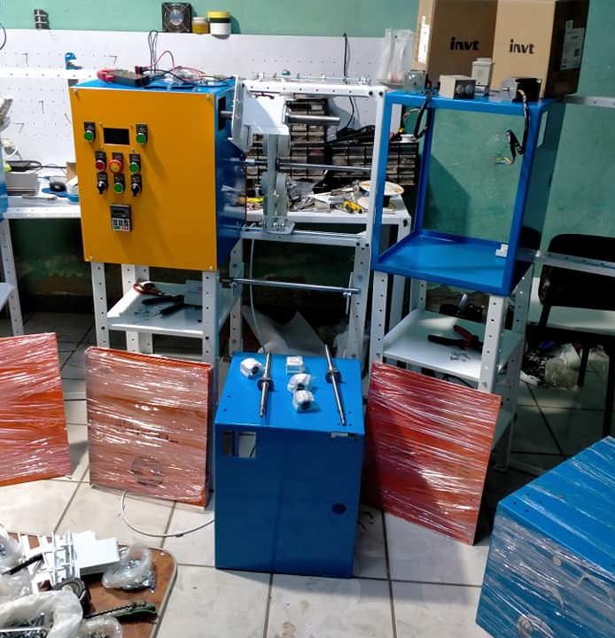

Slide 36
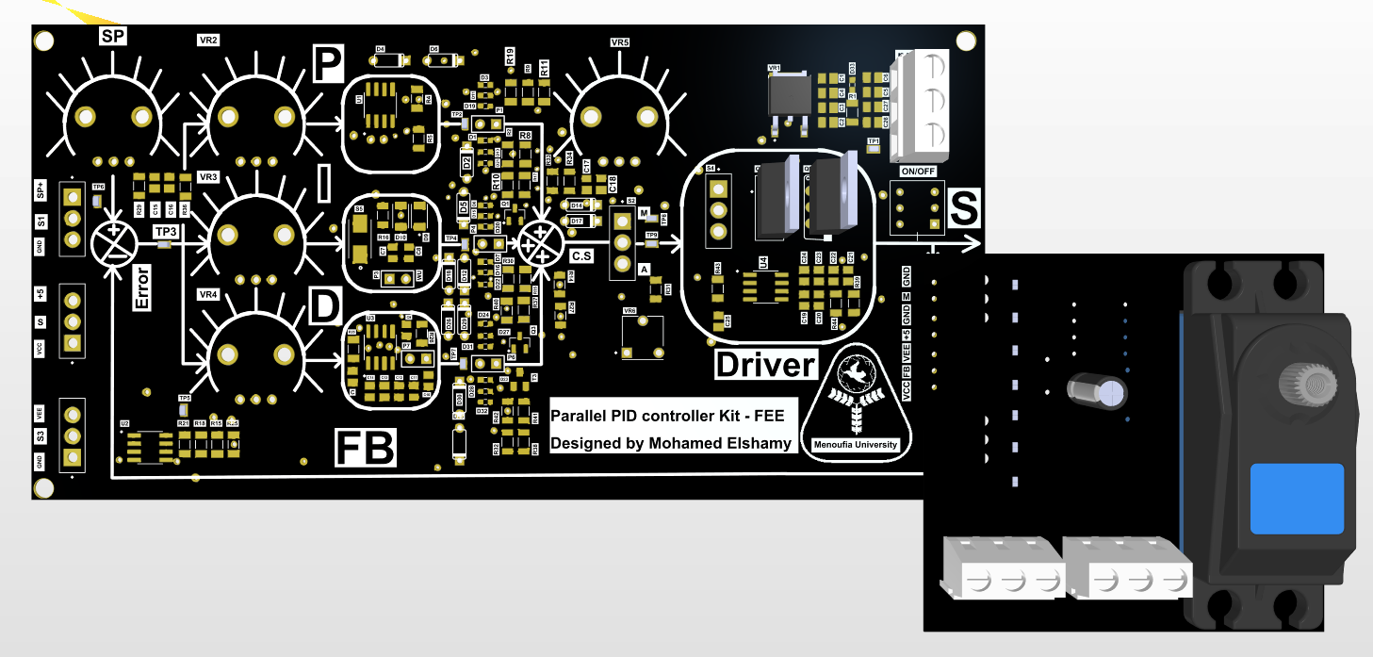

Slide 37
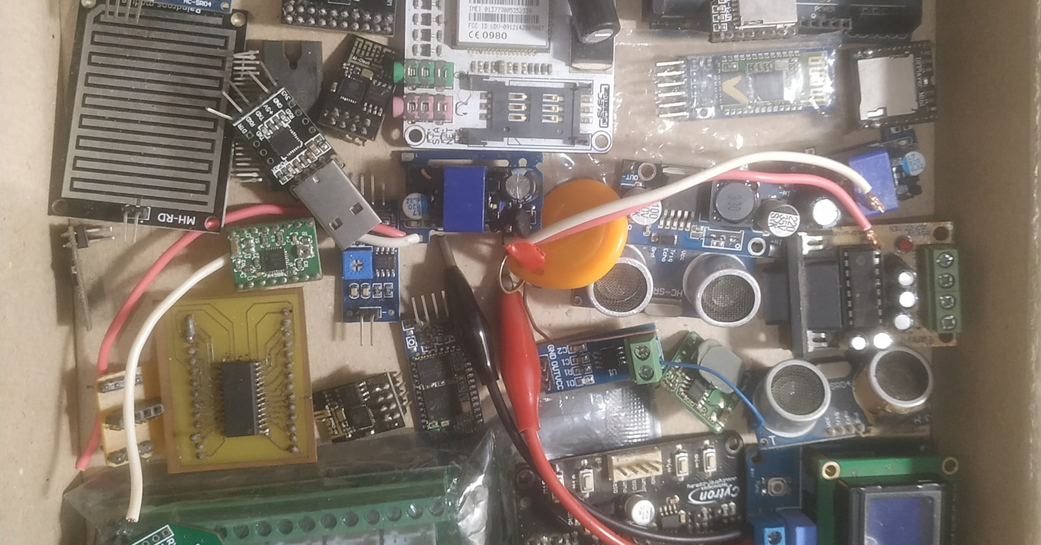

Slide 38
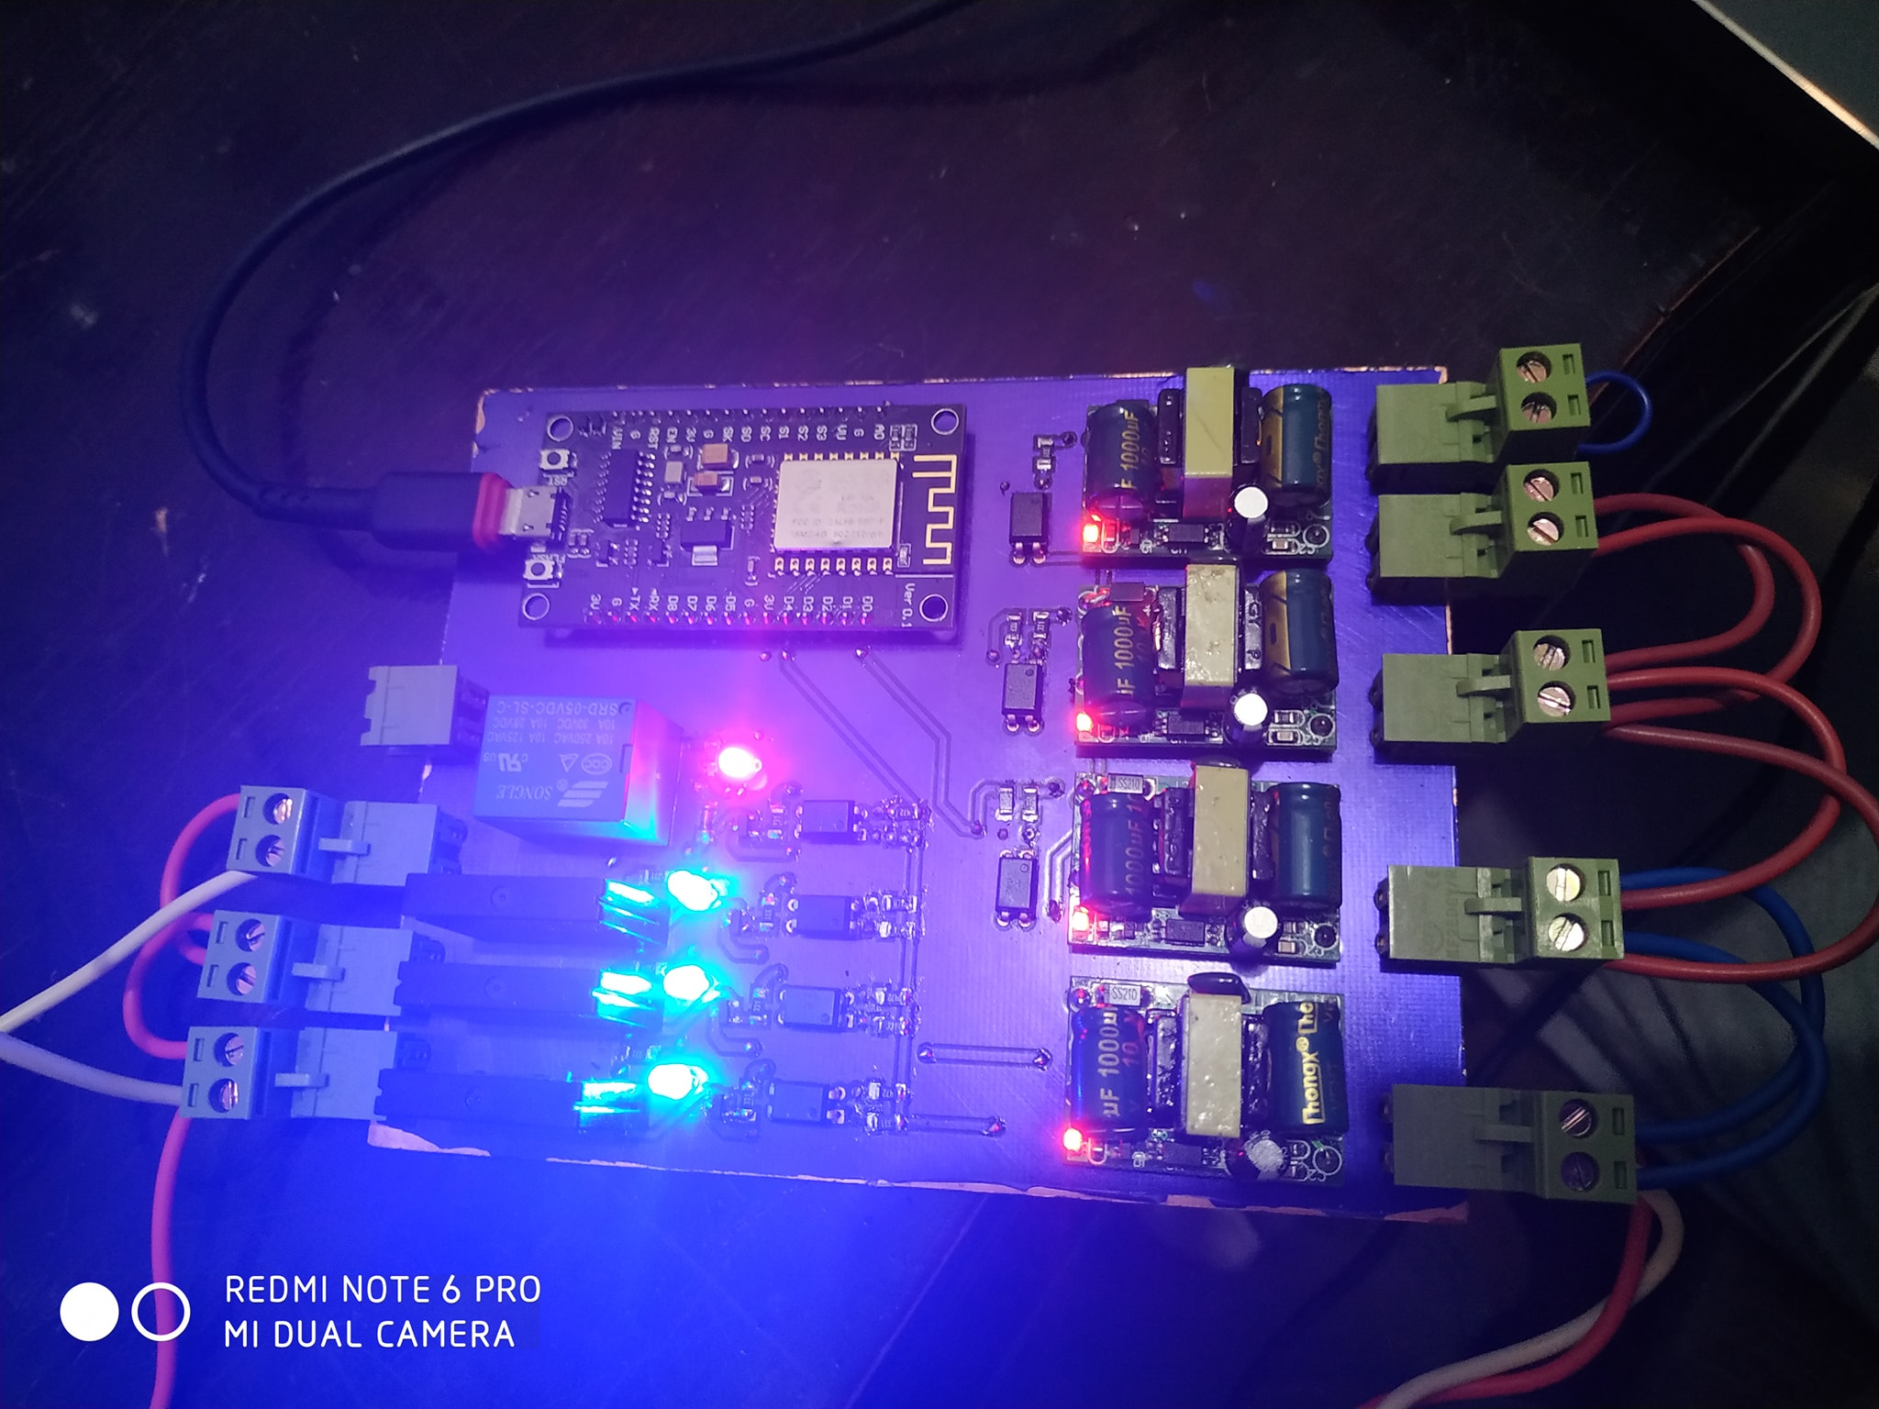
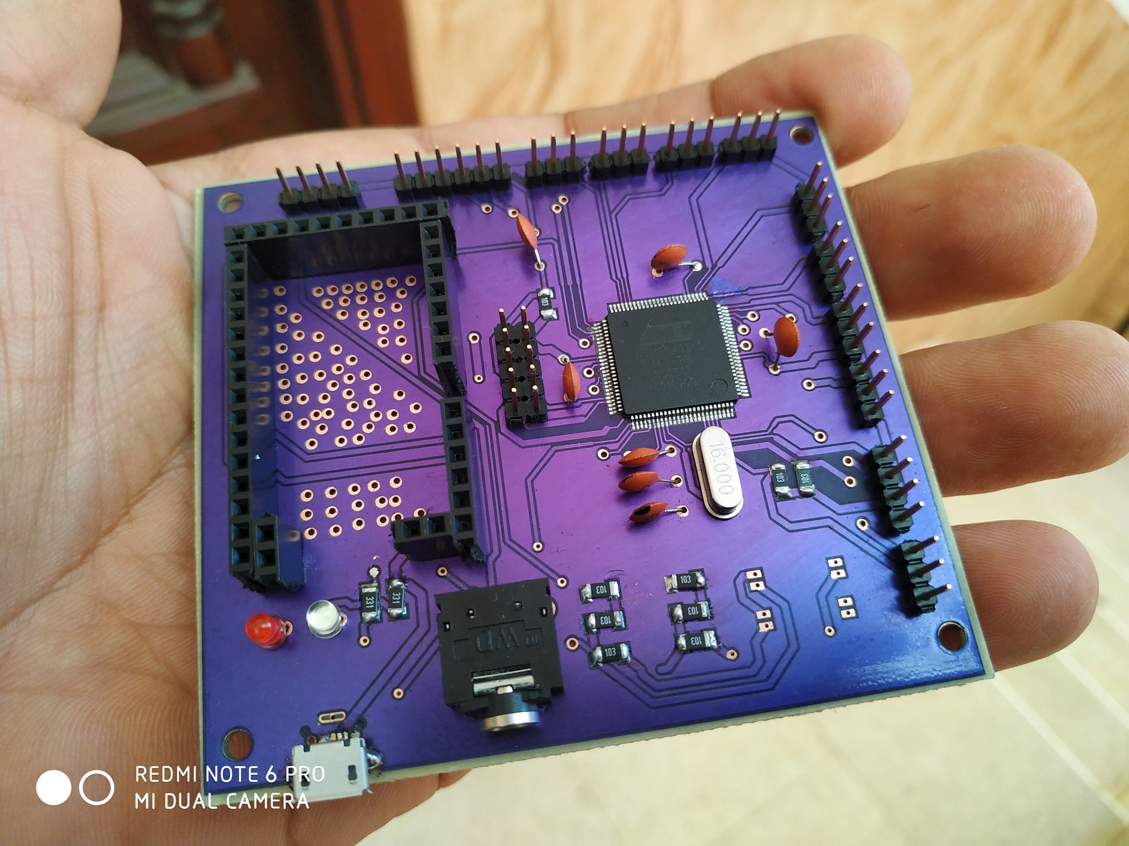

Slide 39


Slide 40


Slide 41


Slide 42


Slide 43

Smart Driving Test Board.

Slide 44

Car tracker devices.

Slide 45


Slide 46


25 – Chevron Radar for Abu Dhabi police with solar power.

Slide 47


Slide 48
YOUTUBE COURSES

